Slide 1
BRONZE STAR
POWERPOINT PRESENTATION

Slide 2
Bronze Star
Assessment
Assessor
Description of tasks
Duration
Access and equity
Complaints, grievances and appeal policy
Course outline
History or RLSSA Australia and Western Australia
The culture of life saving
Legal Considerations
The Good Samaritan
How to call for help

Slide 3
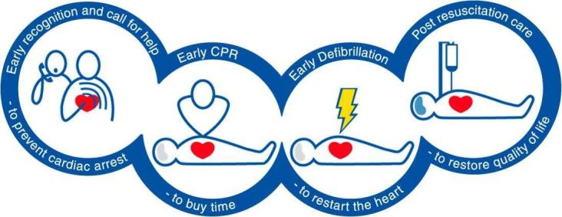
The Chain of Survival
THE CHAIN OF SURVIVAL DESCRIBES THE SEQUENCE OF CRITICAL INTERVENTION STAGES IN THE INITIAL CARE OF A CARDIAC ARREST PATIENT.
The critical stages are:
Early Call For Help
It is essential to attend the casualty and call for help as soon as possible.
Early CPR
This will increase the casualty’s chance of survival by encouraging oxygenated blood flow to the brain.
Early Defibrillation
The restoration of an adequate heart rhythm is necessary for the casualty to survive a cardiac arrest.
Post Resuscitation Care
Transportation of the casualty to hospital by ambulance should not be delayed to enable further treatment and monitoring of their condition.

Slide 4
Emergency Care Procedure
D | DANGER | Check for danger to yourself, bystanders and the casualty. Can whatever caused the problem, harm you or others? Check up down and all around to casualty.
R | RESPONSE | Assess the level of consciousness. Check if the casualty is conscious by asking questions and squeezing their shoulders.
S | SEND FOR HELP | Get bystanders to call for help Ring 000 give clear, precise information
A | AIRWAY | Check and clear the airway Open the mouth and look inside for foreign matter (DO NOT TILT HEAD) Roll onto side if foreign matter is seen then remove by scooping downwards with fingers. If no foreign matter is seen leave casualty on their back.
B | BREATHING | Check for breathing: Tilt head back, look listen and feel for 10 seconds ( 2 breathing cycles) With airway open place cheek to mouth to feel for breathing, one hand placed on diaphragm looking down chest to feel and see chest rising. If casualty is breathing but unconscious place in the recovery position and monitor ABC. Seek medical assistance
C | CPR | 30 compressions : 2 rescue breaths
D | DEFIBRILLATION | Attach AED as soon as possible Follow the directions of the AED

Slide 5
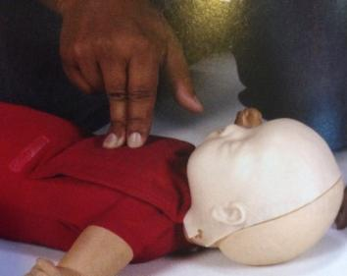
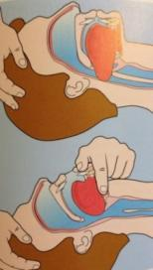
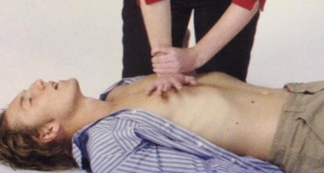
Resuscitation summary chart
 | Adult & older child | Child 1-8 |  | Infant up to 1 year
Head tilt | Full | Full |  | None
Chest pressure | 2 Hands | 1-2 Hands |  | 2 Fingers
Hand placement | Centre of Chest
CPR Ratio | 30 Compressions 2 Breaths
Compressions per min | Approximately 100 Per Minute
Compression depth | One third of the Chest depth
Breathing | Full |  | Half |  | Puff

Slide 6
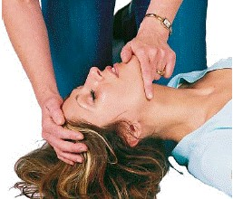
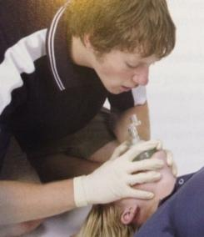
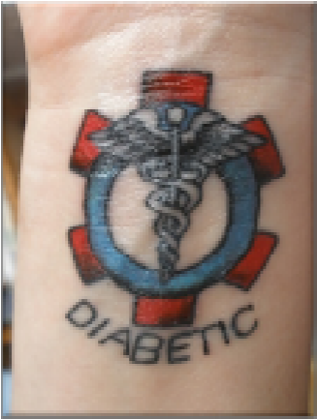
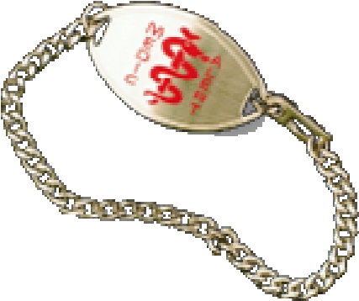
Resuscitation
Airway
Head tilt jaw support
Rescue breathing
mouth to mouth
mouth to mask
mouth to nose
mouth to stoma
mouth to mouth and nose
Complications of rescue breathing
If the chest does not rise
If casualty begins to vomit
If there is air in the stomach
Compressions
Two operator resuscitation
Secondary survey
History
Allergies
Medical alert
Medication

Slide 7
RESUSCITATION DURING PREGNANCY
When resuscitation a casualty believed to be pregnant, complications may occur resulting from pressure on the stomach, diaphragm and lungs from the baby. To provide an optimal situation for resuscitation; padding should be placed under the right buttock of the casualty, to create a ‘LEFT LATERAL TILT’
ensuring reduced pressure on blood vessels and therefore unrestricted flow of blood back to the heart.

Slide 8
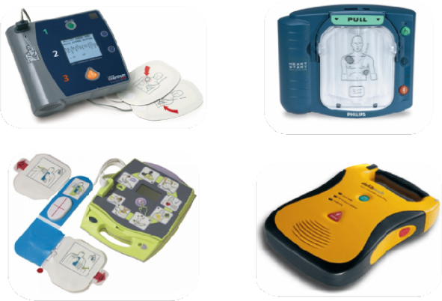
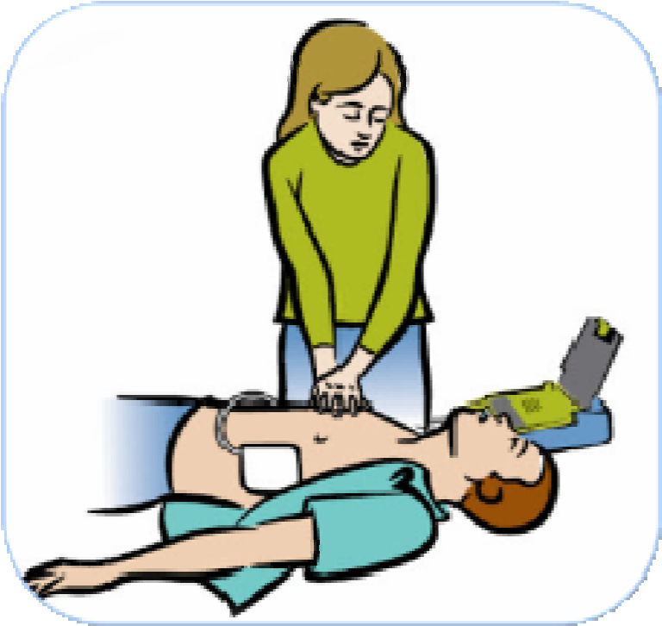
Defibrillation
What is defibrillation
The role of the AED
Why use an AED
Operation of an AED
Steps to using an AED

Slide 9
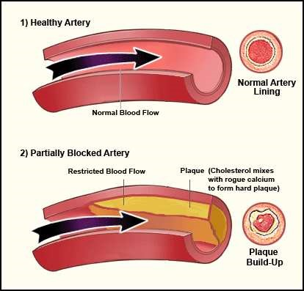
Cardiac Emergencies
Angina attack
Signs and symptoms
Treatment
Heart attack
Signs and symptoms
Treatment
Congestive heart failure
Signs and symptoms

Slide 10
Choking
Signs and symptoms for mild and severe airway obstructions
What to do for mild and severe airway obstructions
Adult And Child
Infants Under 1 Year
Check mouth for object after each back blow or chest thrust

Slide 11
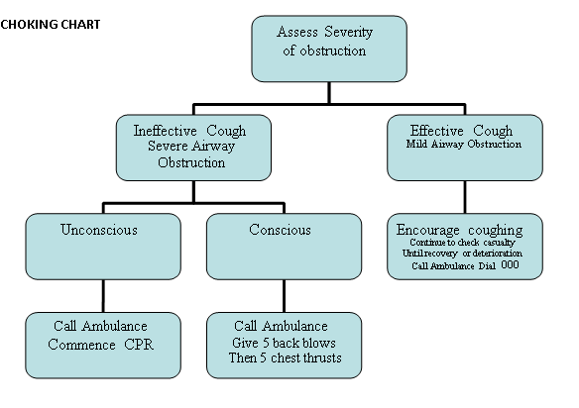
CHOKING FLOW CHART - MILD & SEVERE SYMPTOMS

Slide 12
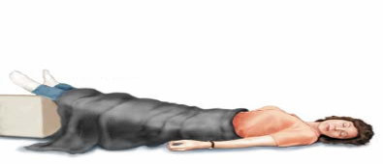
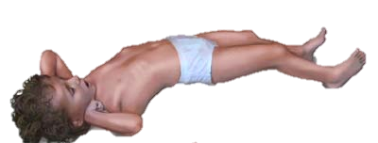
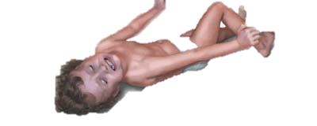
First aid
Shock
Main causes
Signs and symptoms
Treatment
Hyperventilation
Signs and symptoms
Treatment
Bleeding
PER
Convulsions and seizures
Febrile convulsions
Epilepsy
Signs and symptoms
Treatment
Altered conscious state
Diabetes
Hypoglycaemia
Hyperglycaemia
Tonic
Clonic

Slide 13
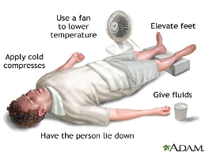
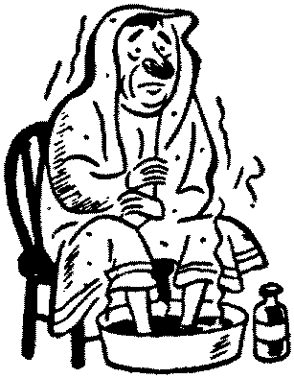
Heat induced illness
Heat Exhaustion
Signs and symptoms
Treatment
Heat stroke
Signs and symptoms
Treatment
Cold induced illness
Hypothermia
Signs and symptoms
Treatment
Body Temperature Chart
26 29 32 35 37 37-39 39+ 42 | Unconscious Hypothermia Very cold (Stop shivering) Cold Normal Fever High fever Unconscious

Slide 14
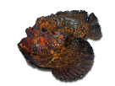
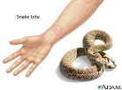
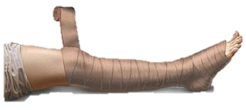
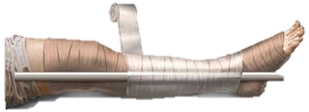
Bites and Stings
HEAT | ICE | VINEGAR | P.I.T
Stone fish Stingray Bull rout Blue bottle Cobbler Sea urchin | Red back White tail Bees Jelly fish Centipede Scorpion | Box Jellyfish Irukandji | Funnel web Snakes Blue ringed Cone shell
Anything with spines | Stop swelling | All stings above the tropics | To slow down poison
P.I.T

Slide 15
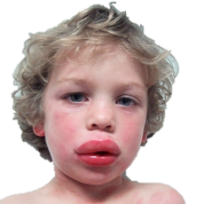
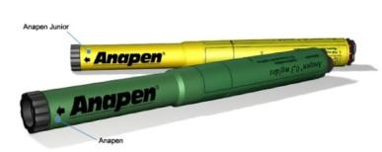
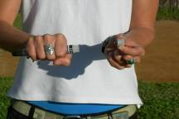
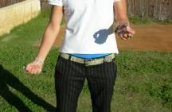
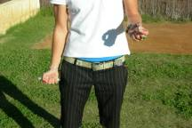
Anaphylaxis
Allergies
Signs and symptoms
Treatment
How to administer an Epi pen

Slide 16
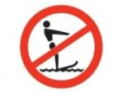
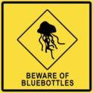
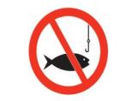
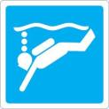
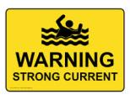
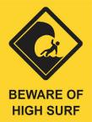
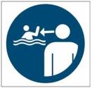
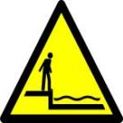
Standard water safety signs
REGULATORY SIGNS | WARNING SIGNS | INFORMATIVE AND PERMISSIVE SIGNS

Slide 17
AQUA CODE

Slide 18
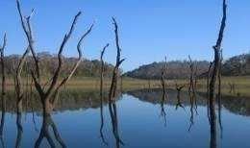
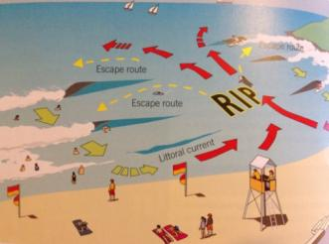
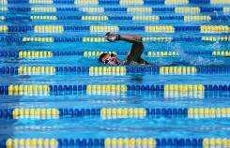
Aquatic Environment
Rivers, Lake and Dams
Dangers
How to stay safe
Beach and Ocean
Dangers
How to stay safe
Swimming pool
Dangers
How to stay safe
Home
Dangers
How to stay safe

Slide 19
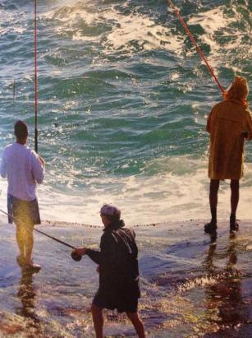
ROCK FISHING SAFETY – KEY MESSAGES from Recfishwest
DON’T PUT YOUR LIFE ON THE LINE
Tell someone where you are going
Never fish alone
Observe first, fish later
Know the area, know the conditions.
Wear appropriate clothing
Wear a PDF
Plan your escape
Use appropriate Public Safety Equipment
Stay alert
If you go in…
Stay calm, swim away from the rocks and remove any heavy or waterlogged clothing. Float on your back and await rescue, or if you’re capable, swim ashore to the safe area you identified from your initial observations.
If you see someone else go in…
Do not jump in if someone is washed into the water. Use your rope or something that floats to help rescue the person. If there’s public safety equipment nearby, know how to use it. Dial 000 or the local Sea Rescue to get help.
For more information please visit www.recfishwest.org.au 9246 3366

Slide 20
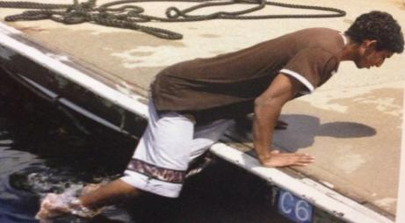
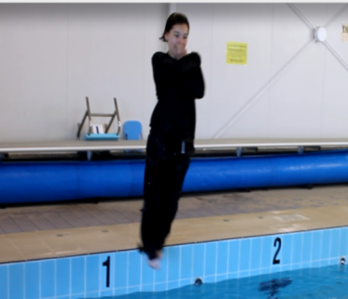
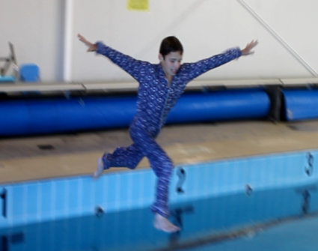
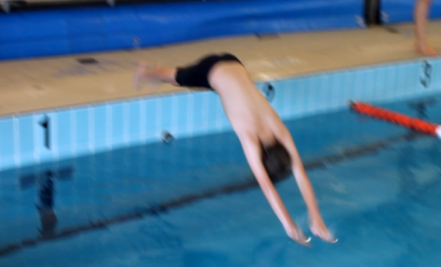
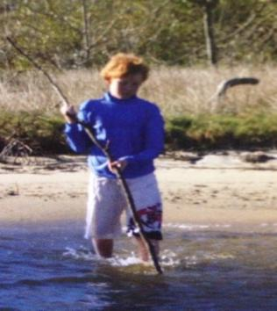
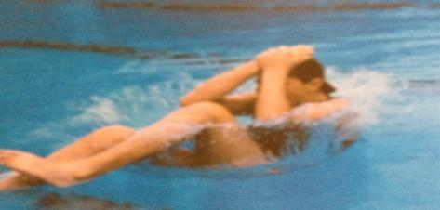
TYPES OF ENTRIES
Slide in entry
Compact Jump
Stride Entry
Dive in Entry
Step in Entry
Accidental Fall in
Wade Entry

Slide 21
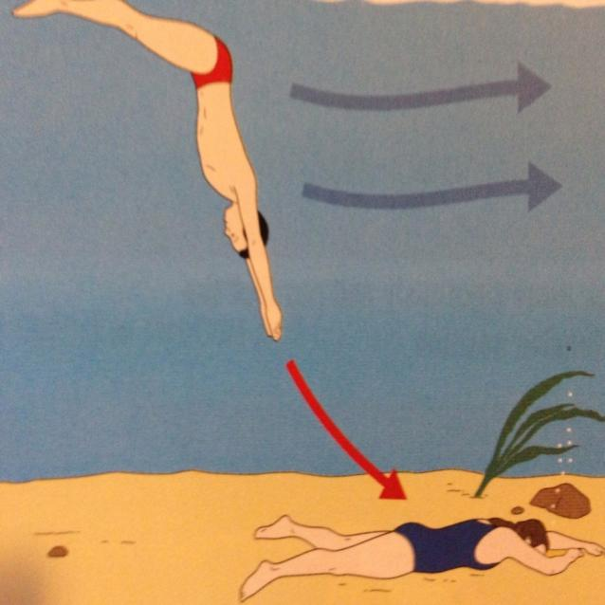
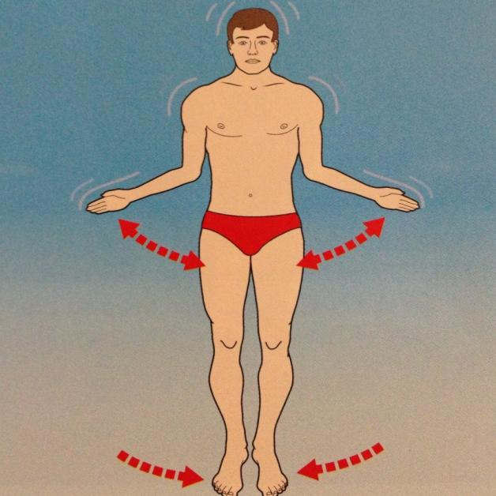
HEAD FIRST AND FEET FIRST SURFACE DIVE

Slide 22
RESCUES
Self preservation is a priority
4 A’s in any rescue
Awareness
Assessment
Action
Aftercare
Categories of persons in difficulty
Non Swimmer
Weak swimmer
Injured swimmer
Unconscious
Rescue techniques
Non swimming –Talk-reach-throw-wade-row
Swimming rescues- swim-tow
TALK, REACH, THROW, WADE, ROW, SWIM, TOW
TO RIDE THE WAVE REALLY SAFE TODAY

Slide 23
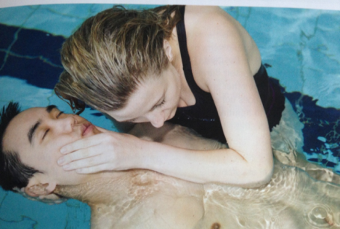
Resuscitation in the water
Shallow water resuscitation
Deep water resuscitation

Slide 24
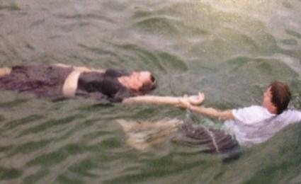
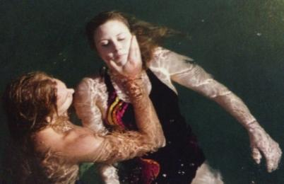
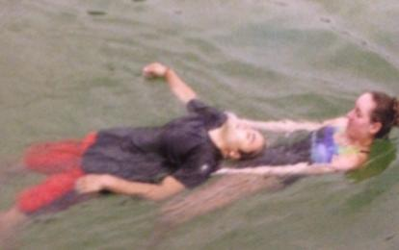
CONTACT TOW TECHNIQUES
Wrist tow
Vice Grip tow
Double armpit tow
Clothes tow
Cross chest tow
Double shoulder Tow
Armpit Tow
Support Tow
Head Tow

Slide 25
DEMONSTRATION OF TEA BAG LIFT

Slide 26
DEFENSIVE POSITIONS

Slide 27
Help And Huddle

Slide 28
SPINAL INJURIES
Signs and Symptoms
Treatment
Management

Slide 29
VICE GRIP – PERFORMED IN DEEP WATER

Slide 30
EXTENDED ARM ROLLOVER

Slide 31
SURVIVAL STRATEGIES AND TECHNIQUES
Survival in deep water depends on the ability to use the following:
KNOWLEDGE – to understand what to do
JUDGEMENT – to decide what to do
SKILL – to perform what is required
FITNESS – to achieve the desired results
The key to survival in cold water
Individual survival strategy
Group survival strategy
YOU LOSE HEAT FROM YOUR HEAD, SIDES OF CHEST AND YOUR GROIN
Putting on a PFD

Slide 32
Search Patterns
Closed Water Search pattern
Open water search pattern

Slide 33
TYPES OF DRUGS AND THEIR AFFECTS
TYPE OF DRUG | EXAMPLES | AFFECT
Stimulants | Speed, cocaine | Affect central nervous system to speed up physical and mental activity
Hallucinogens | LSD | Cause changes in mood, sensation, thought and self-awareness
Depressants | Alcohol, Marijuana | Affect central nervous system to slow down physical and mental activity
Solvents and Aerosols | Glue, paint thinners | Create intoxicating effect

Slide 34
“Almost half of all drowning deaths amongst young adults in Western Australia are contributed to by alcohol.”

