Slide 1
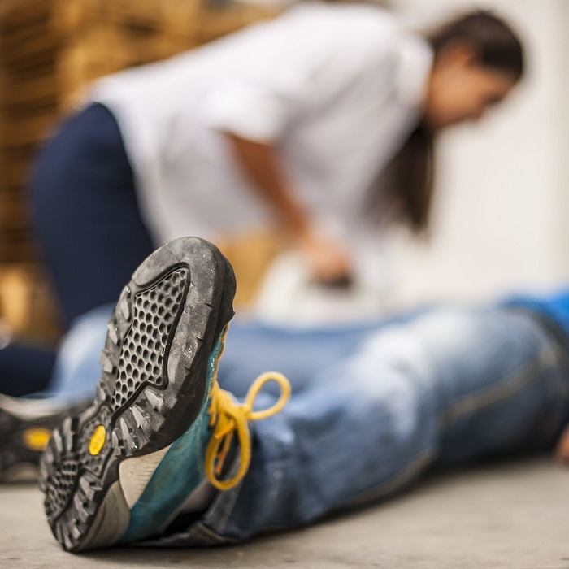
HLTAID003 Provide first aid

Slide 2
HLTAID003 Provide First Aid
Respond to an emergency situation
Apply appropriate first aid procedures
Communicate details of the incident
Evaluate the incident and own performance
Notes:
This training course is based on the unit of competency HLTAID003 Provide First Aid.
This course describes the skills and knowledge required by a worker to provide a first aid response to a casualty in a range of situations including community and workplace settings.

Slide 3
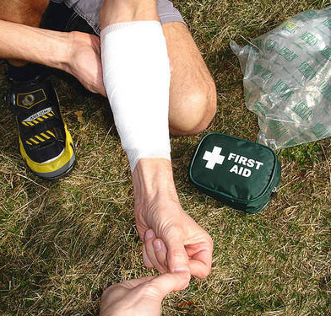
First Aid and Emergencies
The basic principles and concepts of first aid are to:
Save lives.
Relieve pain and suffering.
Avoid further illness or injury.
Protect unconscious individuals.
Encourage recovery.
Prevent/reduce disability.
Notes:
The basic principles and concepts of first aid are to:
Relieve pain and suffering.
Avoid further illness or injury or worsening of illness or injury.
Protect individuals who are unconscious.
Encourage recovery.
Prevent or reduce disability.
Save lives.
Through First Aid training you will learn the skills you need to respond to a medical emergency so you can save lives and reduce pain and injury until qualified medical help takes over.

Slide 4
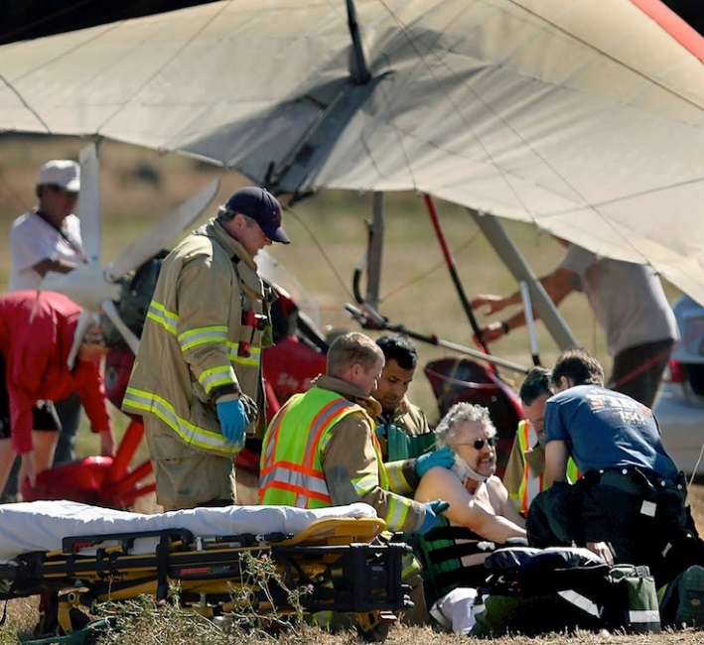
What is an Emergency?
A situation can be defined as an emergency if one or more of the following are present:
Immediate threat to life, health, property or environment.
Loss of life.
A high probability of the situation becoming worse.
Notes:
An emergency is a situation where there is an immediate risk to health, life, property or environment and urgent action is needed to try to stop the situation from getting worse.
A situation can only be defined as an emergency if one or more of the following are present:
Immediate threat to life, health, property or environment.
Loss of life, health detriments, property damage or environmental damage.
A high probability of escalation to cause immediate danger to life, health, property or environment.

Slide 5
Legal, Workplace and Community Factors
Legal, workplace and community factors you need to consider:
Duty of care.
Consent.
Respectful behaviour to a casualty.
Privacy and confidentiality.
Your own skills and limitations.
Stress-management techniques.
Available support following an emergency.
Debriefing.
Notes:
Legal, workplace and community factors you need to consider include:
Duty of care requirements.
Consent.
Respectful behaviour towards a casualty.
Privacy and confidentiality requirements.
Your own skills and limitations.
The need for stress-management techniques and available support following an emergency situation.
The importance of debriefing.
The Code of Practice for first aid requires all employers to ensure that their nominated first aiders attend training on a regular basis to remain current in their skills.
Refresher training in CPR should be undertaken annually. First aid qualifications should be renewed every three years to keep skills current. Any training that lapses past these periods is considered to be out of date.

Slide 6
Legal, Workplace and Community Factors
CPR and First Aid requalification should be done annually.
Training that lapses is considered to be out of date.
It’s a good idea to have practice sessions throughout the year if you don’t use your first aid skills regularly
Notes:
Legal, workplace and community factors you need to consider include:
Duty of care requirements.
Consent.
Respectful behaviour towards a casualty.
Privacy and confidentiality requirements.
Your own skills and limitations.
The need for stress-management techniques and available support following an emergency situation.
The importance of debriefing.
The Code of Practice for first aid requires all employers to ensure that their nominated first aiders attend training on a regular basis to remain current in their skills.
Refresher training in CPR should be undertaken annually. First aid qualifications should be renewed every three years to keep skills current. Any training that lapses past these periods is considered to be out of date.

Slide 7
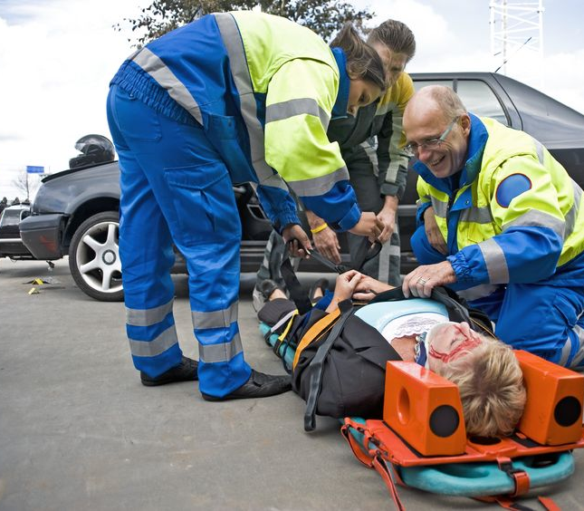
Duty of Care
Once you start providing first aid you must continue until:
Vital signs return.
Paramedic assistance arrives.
Exhaustion makes it impossible to continue.
Authorised personnel declare the casualty deceased.
Notes:
Once you start providing first aid the law says you must continue until:
Vital signs return.
Paramedic assistance arrives from emergency response services.
Exhaustion makes it impossible to continue.
Authorised personnel declare the casualty as officially deceased.
This legal obligation to care is known as ‘duty of care’.

Slide 8
Duty of Care
Duty of care means that you must take reasonable steps to ensure your actions do not knowingly cause harm to another individual.
You don’t legally have to provide treatment, unless you have a previous duty of care to the person.
Notes:
Duty of care means that you must take reasonable steps to ensure your actions don’t knowingly cause harm to another individual.
In a first aid situation you don’t legally have to provide treatment, unless you have a previous duty of care to the injured person.
Some examples of where a duty of care to provide first aid exists include cases where:
You are a worker who is trained, qualified and designated as a first aid officer in a company and you have a duty of care to provide first aid to workers in the company.
You are responsible for the person injured.
You are an official first aid volunteer at a public event.
You have started giving first aid in an emergency.

Slide 9
Duty of Care
A duty of care to provide first aid exists where you are:
You are a worker who is trained, qualified and designated as a first aid officer in a company and you have a duty of care to provide first aid to workers in the workplace.
You are responsible for the person injured.
You are an official first aid volunteer at an event.
You have started giving first aid in an emergency.
Notes:
Duty of care means that you must take reasonable steps to ensure your actions don’t knowingly cause harm to another individual.
In a first aid situation you don’t legally have to provide treatment, unless you have a previous duty of care to the injured person.
Some examples of where a duty of care to provide first aid exists include cases where:
You are a worker who is trained, qualified and designated as a first aid officer in a company and you have a duty of care to provide first aid to workers in the company.
You are responsible for the person injured.
You are an official first aid volunteer at a public event.
You have started giving first aid in an emergency.

Slide 10
Good Samaritan Protection
States and territories have laws that protect people who come “to the aid of a person who is apparently in need of emergency assistance”.
If you provide first aid within your training and without being reckless you are protected from civil liability. If you provide first aid while under the influence of drugs or alcohol you are not protected.
Notes:
Duty of care means that you must take reasonable steps to ensure your actions don’t knowingly cause harm to another individual.
In a first aid situation you don’t legally have to provide treatment, unless you have a previous duty of care to the injured person.
Some examples of where a duty of care to provide first aid exists include cases where:
You are a worker who is trained, qualified and designated as a first aid officer in a company and you have a duty of care to provide first aid to workers in the company.
You are responsible for the person injured.
You are an official first aid volunteer at a public event.
You have started giving first aid in an emergency.

Slide 11
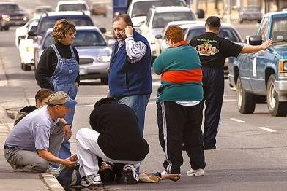
Good Samaritan Protection
In WA the protection is in the Civil Liability Act 2002. It is there to encourage people to respond and provide first aid.
People may hesitate if they are worried about being personally responsible for what happens in a first aid situation.
Notes:
Duty of care means that you must take reasonable steps to ensure your actions don’t knowingly cause harm to another individual.
In a first aid situation you don’t legally have to provide treatment, unless you have a previous duty of care to the injured person.
Some examples of where a duty of care to provide first aid exists include cases where:
You are a worker who is trained, qualified and designated as a first aid officer in a company and you have a duty of care to provide first aid to workers in the company.
You are responsible for the person injured.
You are an official first aid volunteer at a public event.
You have started giving first aid in an emergency.

Slide 12
WHS Legislation and Guidelines
WHS legislation and guidelines help keep your workplace safe
Responsibilities of employers to provide first aid facilities and first aid training.
Requirements of first aid kits and facilities.
Guidelines for preventing accidents.
Procedures on how to deal with a workplace accident.
Notes:
Work Health & Safety (WHS) legislation are the laws and guidelines designed to help keep your workplace safe.
It is important that you are familiar with the WHS laws that exist in your state or territory.
WHS legislation and regulations outline the responsibilities of a person conducting a business or undertaking (PCBUs) to provide first aid facilities and workers trained in first aid. The regulations may also detail the requirements of first aid kits and facilities based on the size of the organisation and the type of work environment.
WHS guidelines for preventing accidents in the workplace should be found in the company’s polices and standard operating procedures. It should have procedures on how to deal with a workplace accident.

Slide 13
WHS Legislation and Guidelines
WHS guidelines for preventing accidents in the workplace should be found in your workplace polices and standard operating procedures. It should have procedures on how to deal with a workplace accident. It will also provide guidance about how to manage risks and hazards in the workplace and during first aid events.
It may include instructions on how to use Personal Protective Equipment (PPE), which can prevent infection spreading.
Notes:
Work Health & Safety (WHS) legislation are the laws and guidelines designed to help keep your workplace safe.
It is important that you are familiar with the WHS laws that exist in your state or territory.
WHS legislation and regulations outline the responsibilities of a person conducting a business or undertaking (PCBUs) to provide first aid facilities and workers trained in first aid. The regulations may also detail the requirements of first aid kits and facilities based on the size of the organisation and the type of work environment.
WHS guidelines for preventing accidents in the workplace should be found in the company’s polices and standard operating procedures. It should have procedures on how to deal with a workplace accident.

Slide 14
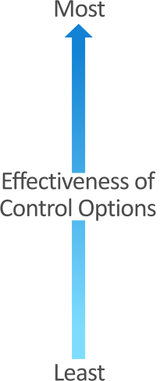
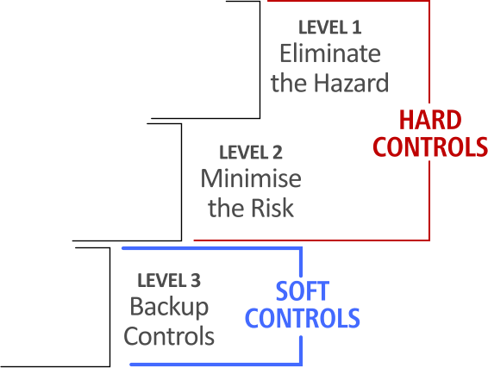
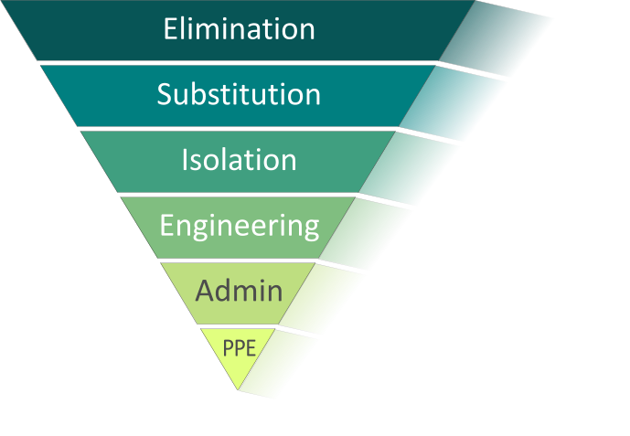
WHS Legislation and Guidelines
Hierarchy of Control
There are 6 levels of control for hazards
Notes:
Work Health & Safety (WHS) legislation are the laws and guidelines designed to help keep your workplace safe.
It is important that you are familiar with the WHS laws that exist in your state or territory.
WHS legislation and regulations outline the responsibilities of a person conducting a business or undertaking (PCBUs) to provide first aid facilities and workers trained in first aid. The regulations may also detail the requirements of first aid kits and facilities based on the size of the organisation and the type of work environment.
WHS guidelines for preventing accidents in the workplace should be found in the company’s polices and standard operating procedures. It should have procedures on how to deal with a workplace accident.

Slide 15
WHS Legislation and Guidelines
How can we control the risk?
• people can be separated from the risk Isolation
• personal protective clothing can be worn eg face mask, gloves PPE
• staff can be trained in First Aid Administration
• lifting equipment can be used Engineering
• power tools can have guards Engineering
• safety switches can be used Engineering
• office furniture can be carefully selected Substitution
• signs to identify First Aid kits Administration
• Prevent trips and falls by removing damaged carpet Elimination
Notes:
Work Health & Safety (WHS) legislation are the laws and guidelines designed to help keep your workplace safe.
It is important that you are familiar with the WHS laws that exist in your state or territory.
WHS legislation and regulations outline the responsibilities of a person conducting a business or undertaking (PCBUs) to provide first aid facilities and workers trained in first aid. The regulations may also detail the requirements of first aid kits and facilities based on the size of the organisation and the type of work environment.
WHS guidelines for preventing accidents in the workplace should be found in the company’s polices and standard operating procedures. It should have procedures on how to deal with a workplace accident.

Slide 16
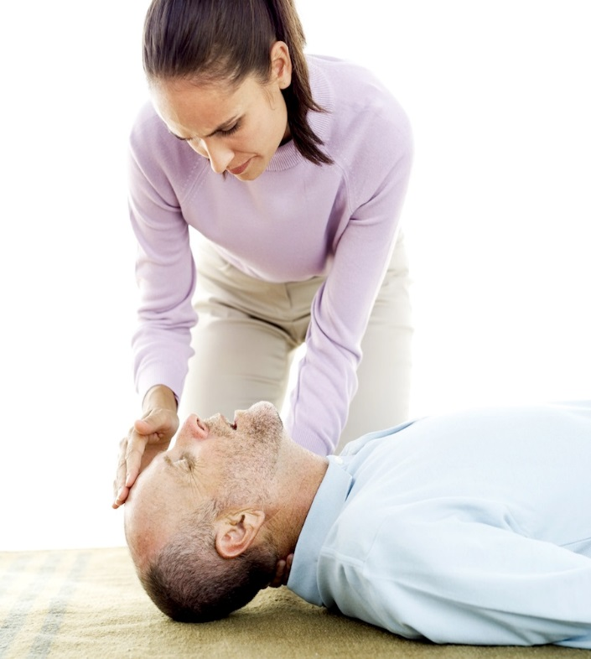
Consent
You must try to get consent.
Informed Consent
If the casualty conscious, you should ask them
Stop if they ask you to.
If you ignore their wishes, you could be charged with assault
Infant/child casualty – get consent from the child’s parent or guardian.
Implied consent
casualty unable to communicate due to injury or unconscious – assumes consent would have been given
Parent or guardian not available
Notes:
If you decide to go ahead with first aid, you must try to get consent from the casualty, and stop if they ask you to.
If the person doesn’t give consent and you touch them or they think you will touch them you could be charged with assault or battery.
You may not always be able to get consent from an injured person, as they may be unable to communicate and/or unconscious.
In these cases the law assumes that the person would have consented if they had been able to, but only if their life and/or future health was in danger.

Slide 17
Showing Respect
Individuals have differing views and beliefs regarding receiving first aid treatment. These may relate to cultural, religious or personal beliefs and customs.
Ways to treat a casualty respectfully include:
Ask for consent and respect their wishes
Being aware of cultural needs
Communicating effectively and explaining what you are doing
Being sensitive to modesty and privacy and aware of impairments
Notes:
It is important to be aware that individuals may have differing views and beliefs regarding receiving medical or first aid treatment. These may relate to cultural, religious or personal beliefs and customs.
Your first aid skills should be applied to the casualty in a way that doesn’t force first aid procedures and respects the individual’s beliefs. You should follow the guidelines for consent with every individual.
Also check the casualty for medical identification tags such as a bracelet or necklace. These will give you information like the name of the casualty, emergency contact, medical illnesses, allergies, and even what medical treatment they would refuse.

Slide 18
Privacy and Confidentiality
Records should be clear and concise as they may be used as a legal document in court. Make sure that any first aid records are accurate, factual and only include your observations and actions, not your opinions.
You should also be aware of privacy and confidentiality legislation. This protects medical data from being circulated to the general public and ensures it is only handled by authorised workers and on a ‘need to know’ basis.
Notes:
It is important to keep records of emergencies and injuries, including what happened and how it was addressed.
Record keeping and reporting requirements can vary between states and territories, industries and organisations.
If you are acting as a first aid officer in your workplace make sure you follow the specific recording guidelines and procedures.
Records should be made and kept for every workplace first aid incident, with copies provided to the organisation.
If providing first aid outside of the workplace you should make a record of the event, or at least keep notes about the first aid you gave.

Slide 19
Privacy and Confidentiality
When giving a verbal report or handover in the workplace or to emergency services, ensure it is done in a way that protects the privacy of the casualty. Each organisation will have policies and procedures for safeguarding sensitive medical information, including first aid details.
Don’t leave first aid reports lying around where they can be seen by unauthorised people. Store and distribute them according to workplace policies and privacy requirements.
Notes:
It is important to keep records of emergencies and injuries, including what happened and how it was addressed.
Record keeping and reporting requirements can vary between states and territories, industries and organisations.
If you are acting as a first aid officer in your workplace make sure you follow the specific recording guidelines and procedures.
Records should be made and kept for every workplace first aid incident, with copies provided to the organisation.
If providing first aid outside of the workplace you should make a record of the event, or at least keep notes about the first aid you gave.

Slide 20
Privacy and Confidentiality
People you can share information with are:
Ambulance officers or paramedics
Nurse or doctor at a hospital
Another first aid responder involved in the incident
Family of the casualty
Notes:
It is important to keep records of emergencies and injuries, including what happened and how it was addressed.
Record keeping and reporting requirements can vary between states and territories, industries and organisations.
If you are acting as a first aid officer in your workplace make sure you follow the specific recording guidelines and procedures.
Records should be made and kept for every workplace first aid incident, with copies provided to the organisation.
If providing first aid outside of the workplace you should make a record of the event, or at least keep notes about the first aid you gave.

Slide 21
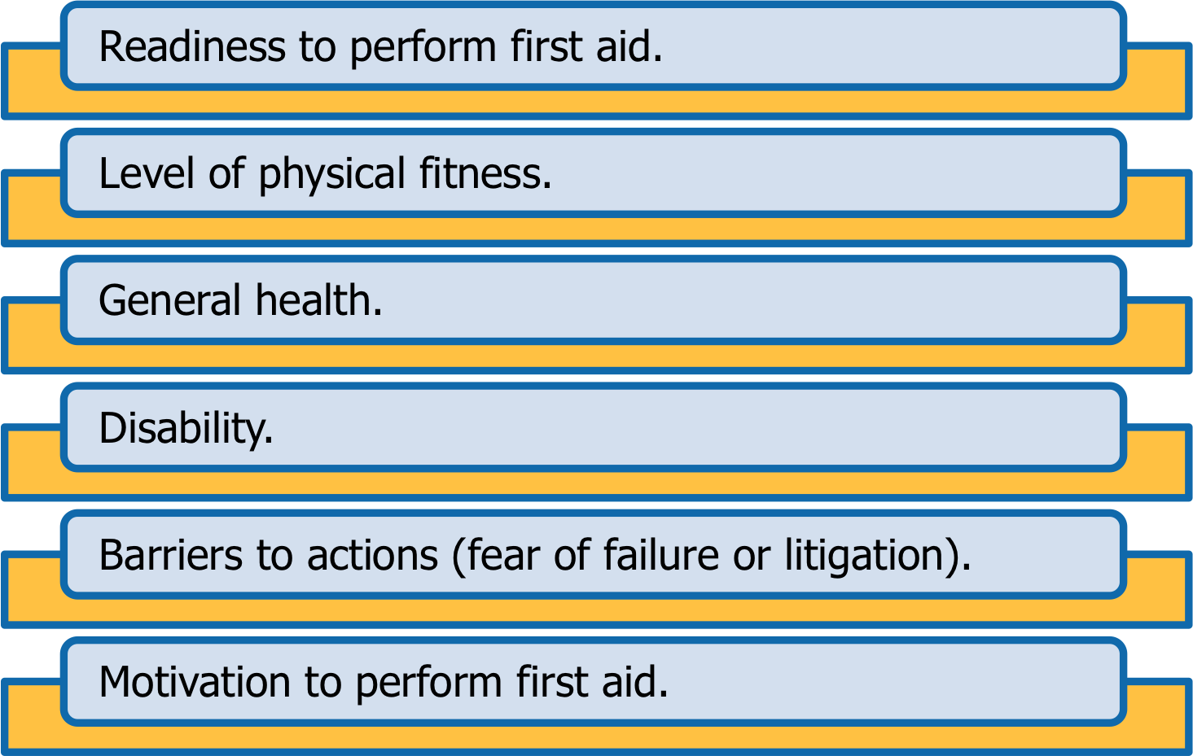
Your First Aid Skills and Limits
Notes:
Be aware of your own personal limitations including:
Readiness to perform first aid.
Level of physical fitness.
General health.
Disability.
Barriers to actions (fear of failure or litigation).
Motivation to perform first aid.

Slide 22
Monitor and Respond to Casualty’s Condition
It is important to monitor and record the condition of the casualty as it can change rapidly with the casualty going in and out of consciousness.
The casualty’s condition can get better or worse according to the treatment you are providing.
When a casualty is in the recovery position keep checking their breathing and to make sure their airway remains clear and open.
Notes:
It is time to finalise your first aid treatment when you see and hear the ambulance arrive. You need to prepare for the hand over of the casualty to the emergency response services personnel who will take over treatment.

Slide 23
Monitor and Respond to Casualty’s Condition
Levels of responsiveness and consciousness:
The priority care for a casualty unconscious on their back and breathing | Place them in the recovery position and monitor their ABC
A conscious casualty can be described as | Alert, responsive to questions and provides accurate answers
A semi-conscious casualty can be described as | Altered conscious state and provides inappropriate or confused answers
An unconscious casualty can be described as | Unresponsive
Notes:
It is time to finalise your first aid treatment when you see and hear the ambulance arrive. You need to prepare for the hand over of the casualty to the emergency response services personnel who will take over treatment.

Slide 24
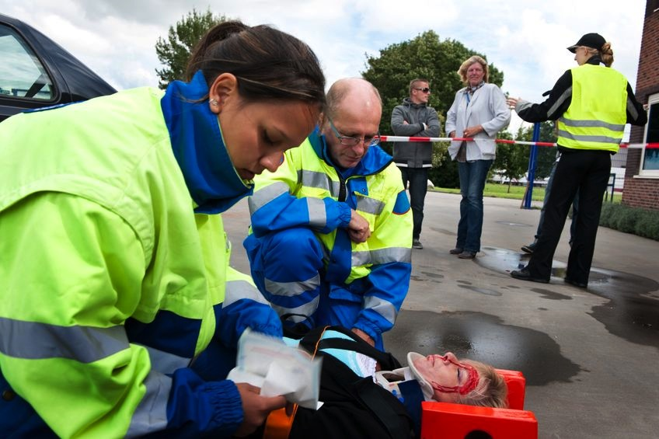
Finalise First Aid Treatment
You need to prepare for the hand over of the casualty to the emergency response services personnel who will take over treatment.
Notes:
It is time to finalise your first aid treatment when you see and hear the ambulance arrive. You need to prepare for the hand over of the casualty to the emergency response services personnel who will take over treatment.

Slide 25
Finalise First Aid Treatment
Providing Assistance
This may involve:
Continuing CPR.
Washing your hands, cleaning and disinfecting the resuscitation mask and other PPE with antiseptic hand rub.
Cleaning and packing away items that belong to the first aid kit.
Providing an incident report or notes – verbally and/or in writing – at the time of treating the casualty (if possible) or right after you have finished while the information is fresh in your mind.
Notes:
It is time to finalise your first aid treatment when you see and hear the ambulance arrive. You need to prepare for the hand over of the casualty to the emergency response services personnel who will take over treatment.

Slide 26
Reporting Incident Details
Emergency services personnel will want some details about the incident and the casualty’s condition.
Be accurate and stick to the facts about what happened.
Try to stay calm and take a few deep breaths before you speak.
Answer any questions and give the information in a calm, clear and concise manner.
Notes:
The paramedics, ambulance officers or other emergency services personnel will want some details about the incident and the casualty’s condition.
You need to be accurate and stick to the facts about what has happened. If you are feeling anxious or stressed, try to stay calm and take a few deep breaths before you speak.
When providing incident details to emergency response services, answer any questions and give the information in a calm, clear and concise manner.

Slide 27
Reporting Incident Details
Reporting to Supervisors
You will also need to provide the same or similar details to your workplace supervisor. This will generally be a written method in the form of an incident report or first aid report. An example of a first aid report is at the end of this manual.
Each workplace has its own incident forms but they should all record similar information about the incident and casualty and follow the privacy laws in your state. When you fill in and sign the form, it becomes a legal document.
Notes:
Incident and casualty details should include:
Name of casualty.
Age.
Address.
Time of incident.
History of incident/injury.
Description of any injuries and/or illness.
Changes in level of consciousness.
Continued…

Slide 28
Evaluate Your Performance
Once you have handed over care of the casualty to professional medical personnel and completed the required reports and forms you should look back and evaluate how well you performed during the emergency.
This includes recognising and dealing with any psychological impacts the incident might have had on yourself and the other rescuers.
Notes:
Once you have handed over care of the casualty to professional medical personnel and completed the required reports and forms you should look back and evaluate how well you performed during the emergency.
This includes recognising and dealing with any psychological impacts the incident might have had on yourself and the other rescuers.

Slide 29
Recognising Psychological Impacts
Not everyone who is involved in critical incidents will be badly affected but some people can suffer from mental health issues.
The signs of trauma or stress may include:
Emotional outbursts.
Irritability.
Disturbed sleep.
Flashbacks.
Feeling numb.
Anxiety.
Notes:
Not everyone who is involved in critical incidents will be badly affected but some people can suffer from mental health issues such as Post-Traumatic Stress Disorder (PTSD).
The signs of trauma or stress may include:
Emotional outbursts.
Irritability.
Disturbed sleep.
Flashbacks.
Feeling numb.
Anxiety.

Slide 30
Dealing with Stress
To help you deal with stress you could try talking to a friend, co-worker or trained counsellor for support. This is called debriefing.
To access counselling:
Visit your GP for a referral.
Employee Assistance Program
Community health services.
Telephone counselling.
Debrief with other first aid responders
Notes:
To help you deal with stress you could try talking to a friend, co-worker or trained counsellor for support. This is called debriefing.
You might visit your GP (family doctor) who can refer you to a qualified psychologist if necessary.
Community mental health services also provide counselling.
Telephone counselling services can be found in the current White Pages directory under the “Advice and Assistance” section.

Slide 31
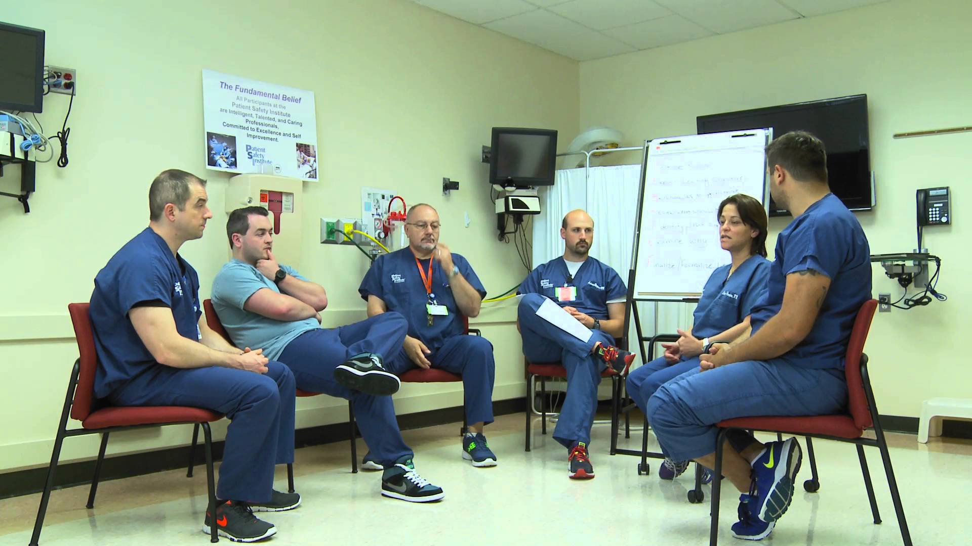
Debriefing and Self-evaluation
Go back over the situation in your mind.
Were there things you could have done better?
Was there anything you couldn’t do because you had forgotten or never learned something?
Be honest with yourself and always be on the lookout to improve your skills.
Notes:
Go back over the situation in your mind. Were there things you could have done better? Was there anything you couldn’t do because you had forgotten or never learned something? Be honest with yourself and always be on the lookout to improve your skills.
Your organisation can also learn from your experience and develop methods to improve emergency response techniques.
Your supervisor might decide to send you to relevant training courses for professional development and to update the skills needed to become a better first aider. Debriefing may also give you closure on the incident.

Slide 32
Debriefing and Self-evaluation
Debriefing and evaluation are important because it helps you and other first aid responders to deal with the stress from a traumatic incident.
It also helps you and your workplace improve the way you provide first aid in the future.
Debriefing is also important to give emergency services details about what happened and what first aid was provided for the handover.
Notes:
Go back over the situation in your mind. Were there things you could have done better? Was there anything you couldn’t do because you had forgotten or never learned something? Be honest with yourself and always be on the lookout to improve your skills.
Your organisation can also learn from your experience and develop methods to improve emergency response techniques.
Your supervisor might decide to send you to relevant training courses for professional development and to update the skills needed to become a better first aider. Debriefing may also give you closure on the incident.

Slide 33
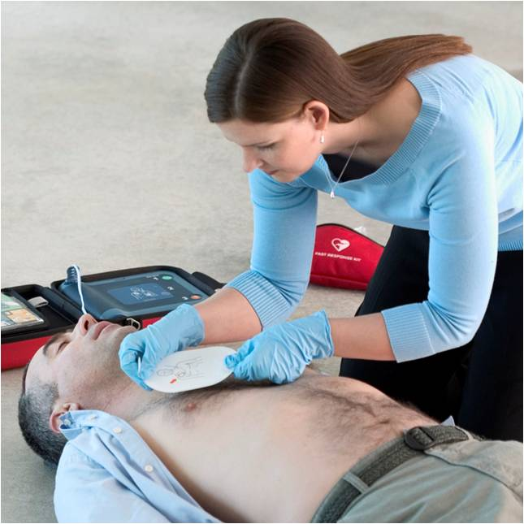
Principles of First Aid
When you are providing first aid it is important to understand the 4 established first aid principles:
Preserve life.
Prevent illness, injury and condition(s) becoming worse.
Promote recovery.
Protect the unconscious casualty.
Notes:
When you are providing first aid it is important to understand the established first aid principles. The 4 principles are:
1. Preserve life.
2. Prevent illness, injury and condition(s) becoming worse.
3. Promote recovery.
4. Protect the unconscious casualty.

Slide 34
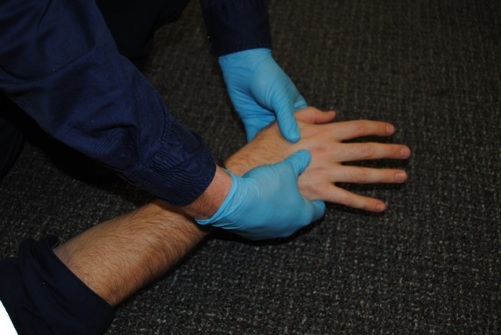
Maintain Hygiene
Standard infection control procedures include:
Wearing protective gloves.
Covering any cuts or skin conditions.
Cleaning away blood and other body fluids.
Not touching your face, especially your mouth, ears and eyes.
Also avoid, eating and drinking.
Washing your hands thoroughly.
Disposing of contaminated waste in biohazard containers.
Correctly disposing of contaminated sharp objects (such as needles).
Using a protective face mask for resuscitation.
Notes:
As a first aider you could come into contact with human blood and bodily fluids like saliva. These can carry viruses or bacteria, which cause diseases. You therefore need to pay attention to proper hygiene and standard infection control procedures.

Slide 35
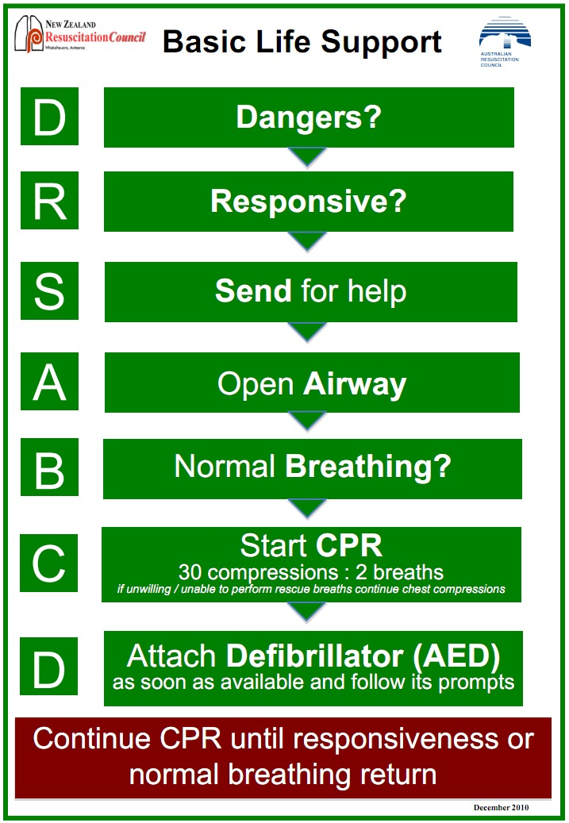
DRS ABCD Action Plan
Notes:
A very important part of emergency first aid treatment is the ARC’s ‘Basic Life Support’ chart. It shows the “DRS ABCD” process for performing resuscitation or CPR.
You should follow these ARC guidelines for each stage of the “DRS ABCD” process.
D – Dangers.
R – Responsive.
S – Send for help.
A – Open Airways.
B – Normal Breathing.
C – Start CPR.
D – Attach Defibrillator.

Slide 36
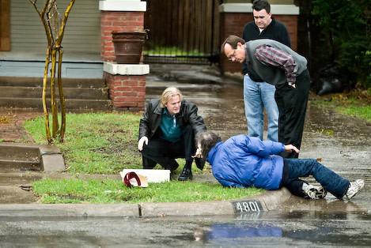
D – Dangers
Assess the scene
Identify and treat the hazards
Build up a picture of the incident and try to determine the Mechanism of Injury
Form a plan of treatment
If the casualty is in immediate danger you should move them, but only if it is safe to do so.
Notes:
Check the surrounding area and make sure it’s safe for you, the injured person and others in the area. Do this by looking, listening and smelling.
If the casualty is in immediate danger you should move them, but only if it is safe to do so. Try to lift or move the person in a way that won’t hurt them more, and remember to protect yourself from back strain or other injuries.

Slide 37
Survey the Scene
While you are surveying the scene, you might come across some barriers to action.
Types of Barriers | Presence of bystanders.
 | Uncertainty about the person.
 | Nature of the illness/injury.
 | Fear of disease transmission.
 | Fear of doing something wrong.
Notes:
While you are surveying the scene, you might come across some barriers to action. These barriers may be in the form of:
Possible Barriers & Description:
Presence of Bystanders
You might feel embarrassed performing first aid in front of others or you may assume someone else will be doing it.
Uncertainty about the Person
The injured person may be a stranger, older, younger, different gender or race. You should provide assistance anyway even it is only by calling ‘000’.
Nature of the Illness/Injury
The emergency may be unpleasant or confronting (blood, vomit etc.). You should still try to do as much as possible. If needed take a moment to collect yourself but remember – it is still an emergency.
Fear of Disease Transmission
The risk of disease transmission is actually quite small. If you take appropriate precautions you can greatly reduce the risks.
Fear of Doing Something Wrong
As long as you do everything reasonably possible and follow your duty of care you shouldn’t worry about making an error. Some first aid is better than no first aid.

Slide 38
Assess the Scene and Casualty
The Emergency Action Process can be followed to plan your response.
The steps should be followed to conduct the initial assessment.
Notes:
The Emergency Action Process can be followed to plan your response to an emergency and in providing first aid. The Emergency Action Process steps should be followed to conduct the initial assessment.
These steps are:
1. Survey the scene.
2. Conduct a primary survey.
3. Complete a secondary survey.

Slide 39
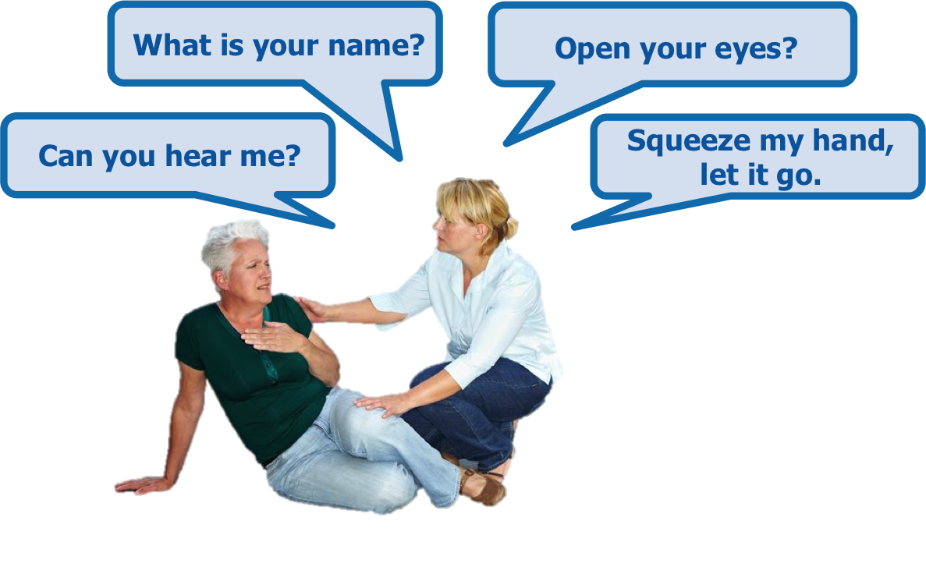
D R – Responsive
Check the patient’s responses by using the “Talk and Touch Method”.
Notes:
Check the patient’s responses by talking and touching them (squeezing their shoulders). This is referred to as the “Talk and Touch Method”.
You may say:
Can you hear me?
What is your name?
Open your eyes.
Squeeze my hand – let it go.

Slide 40
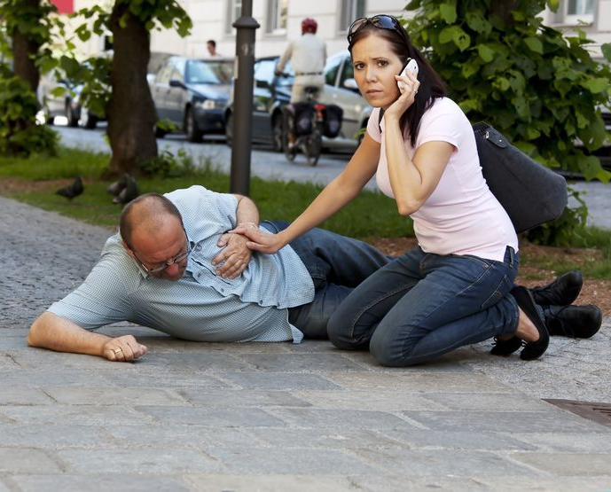
R – Responsive
If the patient responds they are conscious and breathing – make them comfortable and check them for any injuries.
Call for help if required and keep monitoring them for at least 10-15 minutes.
If you don’t get a response call 000 immediately.
A person who doesn’t respond is unconscious.
Notes:
If the patient responds they are conscious, breathing and have a pulse. Make them comfortable and check them for any injuries using the secondary survey technique.
Call for help if required and keep monitoring them for at least 10-15 minutes before letting them move.
If you don’t get a response call 000 immediately.
A person who doesn’t respond is unconscious. This is potentially life-threatening as they could choke, their breathing might stop or they could bleed to death.

Slide 41
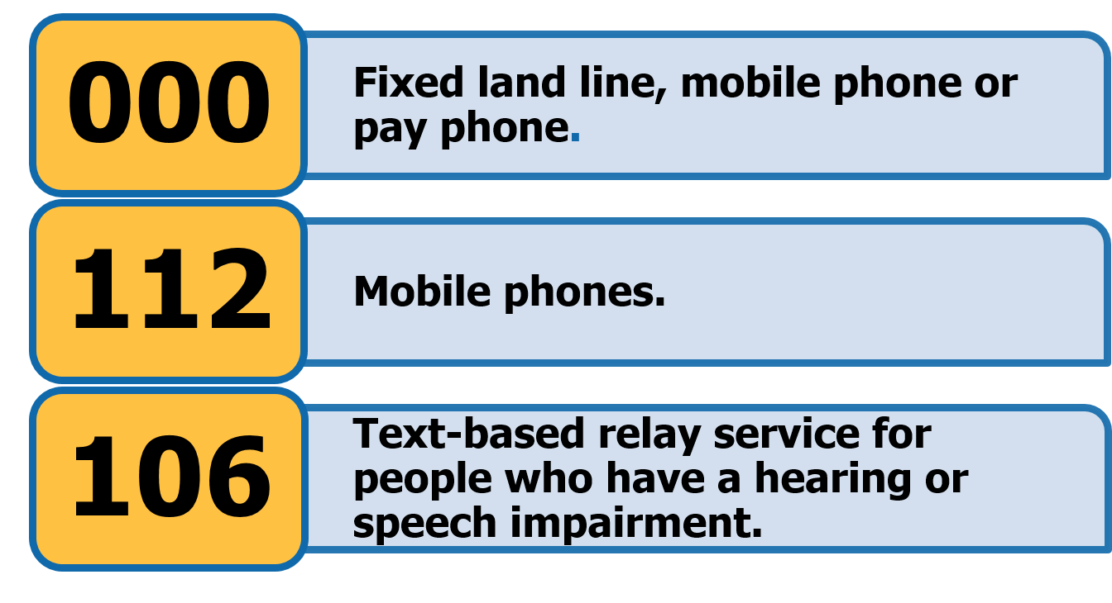
D R S – Send For Help
Dial for an ambulance or medical assistance as soon as possible.
Notes:
Dial for an ambulance or medical assistance as soon as possible.
000 – Can be dialed from any fixed land line, mobile phone or pay phone.
112 – Can be used from mobile phones.
106 – Connects to the text-based relay service for people who have a hearing or speech impediment.

Slide 42
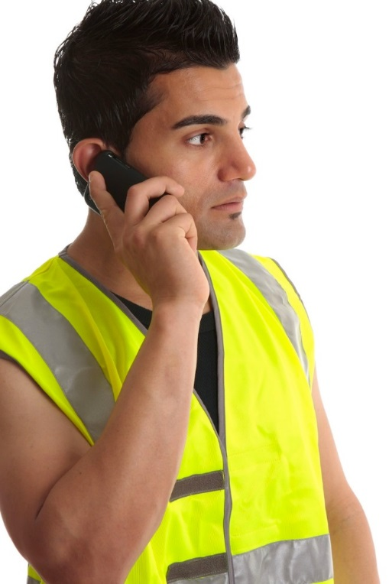
S – Send For Help
When calling emergency services let the operator know:
Where the emergency happened.
When the emergency happened.
What happened.
What is being done.
Who you are and the number you are calling from.
Who the casualty is, if known.
DO NOT hang up the phone until you have been given instructions on how to proceed.
Notes:
When calling emergency services (by dialling 000) let the operator know the following details:
Where and when the emergency happened – the exact address/location, including city/town, nearby crossroads/main roads, landmarks, building name, floor, room number as applicable. The more details the caller can provide the easier it will be for emergency response services personnel to find you.
What happened – car accident, fall, drowning etc., how many people are involved and the condition of the casualty/s (bleeding, unconscious, chest pain etc.).
What is being done – details of the first aid that is being/has been provided so far.
Who you are and the number you are calling from – in case the call is dropped.
Who the casualty is, if known.
DO NOT hang up the phone until you have been given instructions on how to proceed.

Slide 43
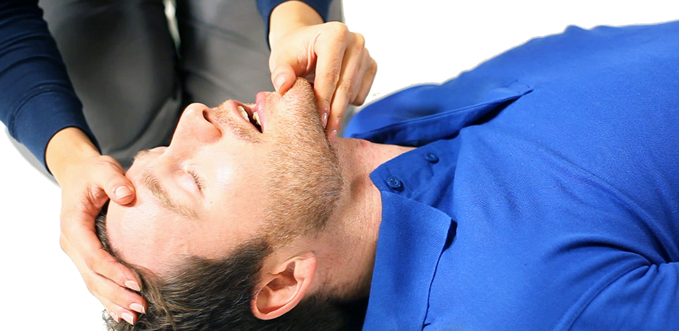
D R S A – Airway
Check that the casualty’s airway is clear so that their breathing is not obstructed.
Use the head tilt/chin lift technique.
One hand is placed on the casualty’s forehead to tilt the head back
fingers of the other hand are placed on the chin to lift it up and outward.
Gently open the mouth by pulling down on the jaw to check for any obstruction.
If there is any foreign material present you should move the casualty into the recovery position and allow the material to drain out, including when casualty vomits/regurgitates.
Notes:
The next step is to check that the casualty’s airway is clear so that their breathing is not obstructed (blocked).
To check their airway, use the head tilt/chin lift technique as this helps lift the tongue from the back of the throat.
One hand is placed on the casualty’s forehead to tilt the head back while the fingers of the other hand are placed on the bony part of the chin to lift it up and outward.
The mouth should then be gently opened by pulling down on the jaw to check for any obstruction. If there is any foreign material present you should move the casualty into the recovery position and allow the material to drain from the mouth. This should also be the action taken if the casualty vomits/regurgitates.
An open airway is the most important thing, even if you think the casualty has a spinal injury.

Slide 44
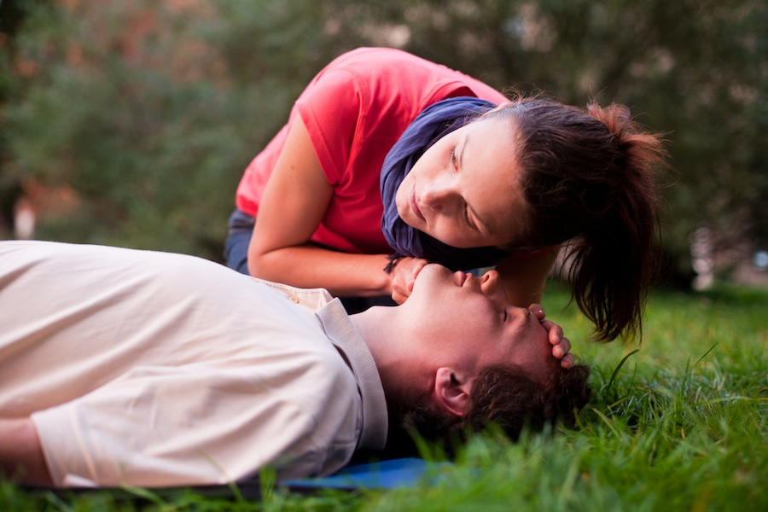
D R S A B – Breathing
While keeping the airways open, check for normal breathing signs for 10 seconds:
Look.
Listen.
Feel.
This is easier to do when the injured person is on their back.
Notes:
While keeping the airways open, look, listen and feel for normal breathing signs. This is often easier to do when the injured person is on their back but can also be done while they are in the recovery position
For a full 3-5 seconds you should position yourself so that you can hear and feel if air is escaping from the nose and mouth. Also watch the chest and abdomen to see if they rise and fall with air movement.

Slide 45
B – Breathing
If the casualty is breathing normally, position them in the Recovery Position and again check their airway and head position.
Check their airway after one minute and then every two minutes.
Call for emergency services while continuing to monitor them.
If the casualty is NOT breathing normally and there are no signs of life then you will need to begin CPR.
Notes:
If the casualty is breathing normally, position them in the recovery position and again check their airway and head position.
Check their airway after one minute and then every two minutes.
If you or someone else has not called for emergency services do so now, while continuing to check the airway and vital signs until they arrive.
If the casualty is NOT breathing normally and there are no signs of life then you will need to begin CPR.

Slide 46
The Recovery Position
This is the best position for a casualty who is unconscious and breathing
It keeps their airway open
Prevents asphyxiation.
Allows for drainage of vomit and saliva
Notes:
This is the best position for a casualty who is unconscious and breathing. It keeps their airway open and allows any vomit to drain onto the floor so they don't choke on it. It is important that the casualty is put into the recovery position, as it will prevent asphyxiation due to body position.
1. Kneel beside the person – they should still be on their back.
2. Place the casualty’s arm furthest from you across their chest, with the back of their hand against their cheek or on the opposite shoulder.
3. Position the arm that is closest to you at a right angle to their body along the ground.
Continued…

Slide 47
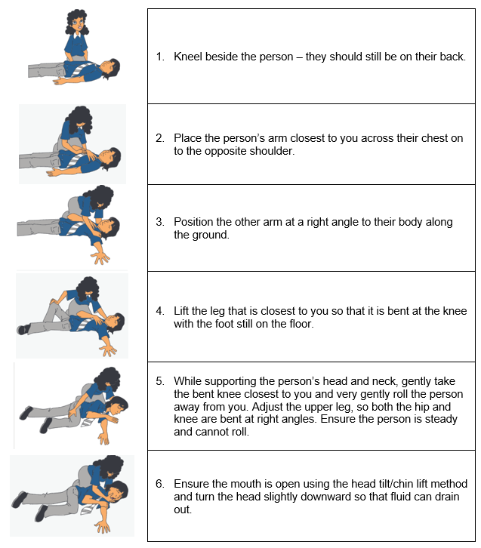
Notes:
This is the best position for a casualty who is unconscious and breathing. It keeps their airway open and allows any vomit to drain onto the floor so they don't choke on it. It is important that the casualty is put into the recovery position, as it will prevent asphyxiation due to body position.
1. Kneel beside the person – they should still be on their back.
2. Place the casualty’s arm furthest from you across their chest, with the back of their hand against their cheek or on the opposite shoulder.
3. Position the arm that is closest to you at a right angle to their body along the ground.
Continued…

Slide 48
D R S A B C – CPR (Cardio Pulmonary Resuscitation)
If the casualty is unconscious and not breathing you must start CPR immediately
The initial assessment is very important
If the casualty has been assessed to be in a life and death situation, appropriate life saving strategies are urgently needed.
If CPR is not done quickly the casualty won’t have enough oxygen. Brain damage is possible after 4 minutes.
CPR consists of 30 chest compressions and 2 rescue breaths
Notes:
Cardiopulmonary Resuscitation (CPR) is the name given to the technique of combining rescue breaths with external cardiac compressions.
When CPR is applied to the casualty, body systems such as the brain and the heart are affected as oxygen is being pumped into the blood through the circulatory system.
CPR can save lives or increase the chance of survival for the casualty until qualified medical help takes over.

Slide 49
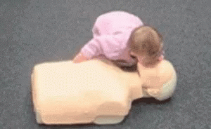
C – CPR
Ensure the person is lying on their back on a flat surface
Kneel beside the person between the head and chest
Find the correct position - middle of the chest
Interlock fingers and apply pressure with the heel of your hand
Use 2 hands for adults, 1 hand for a child and 2 fingers for an infant
Shoulders directly over your hands to push straight down
Elbows locked to use your upper body strength not just your arms
Compress to one third of chest height
Maintain a steady rhythm of 100 compressions a minute
After 30 compressions perform 2 rescue breaths
Notes:
CPR consists of 30 chest compressions and 2 rescue breaths.
Follow these directions when administering CPR:
1. Ensure the person is lying on their back, if possible on a flat, hard surface, and with their head at the same level as their heart.
2. Kneel Beside the person, midway between the head and chest for ease of movement between giving breaths and compressions.
3. Find the correct hand position – this is in the centre of the chest.
4. Apply pressure to the sternum with the heel of your hand, keeping your fingers up.
Continued…

Slide 50
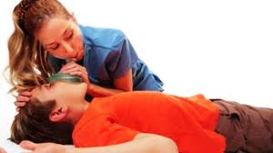
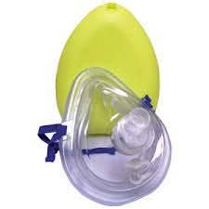
Rescue Breaths
After every 30 compressions you need to deliver 2 rescue breaths.
Whenever possible use a resuscitation face mask or shield.
Notes:
After every 30 compressions you need to deliver 2 rescue breaths.
To do this:
1. Position the head using the head tilt/chin lift method. The ‘pistol grip’ is often the best and easiest way to hold and position the jaw.
2. Take a breath and place your mouth over the person’s mouth.
3. Pinch their nose or seal it with your cheek.
4. Blow into their mouth and then turn your head to see if their chest rises and falls with the breath. This will show whether your breath has reached their lungs. It also stops you from inhaling their exhaled breath and lets you hear air escaping from their mouth.
5. If the chest does not rise and fall, adjust the position of the person’s head, being careful not to lift, twist or turn their neck.
6. Repeat with a second breath.

Slide 51
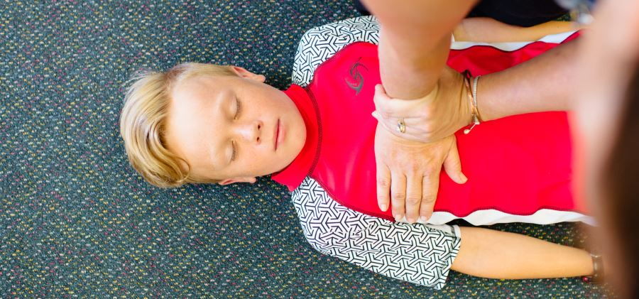
Rescue Breaths
If signs of life return place the person in the recovery position. It is more important that CPR is not interrupted too often.
If you are unwilling to give mouth-to-mouth you should at least continue to administer chest compressions – any resuscitation is better than none.
DO NOT STOP until emergency help arrives.
Notes:
If signs of life return – consciousness, normal breathing, moving – place the person in the recovery position.
It is more important that CPR is not interrupted too often to check for signs of life as regular checking has been shown to reduce survival rates.
If you are unwilling to give mouth-to-mouth you should at least continue to administer chest compressions – any resuscitation is better than none.
DO NOT STOP until emergency help arrives.

Slide 52
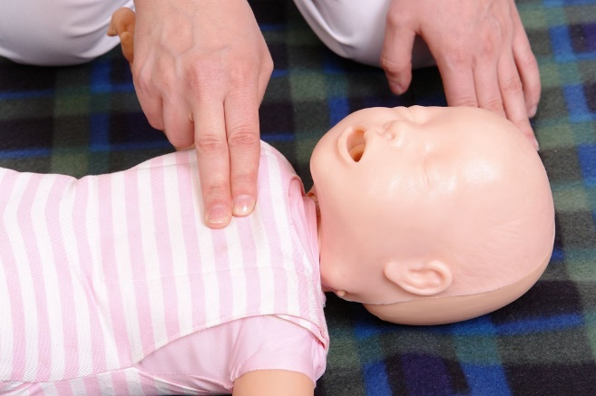
Infant and Child CPR
When giving CPR to infants and children the same process for adult CPR should be followed, however CPR on infants requires some adaptions:
Opening the airway using the head tilt – chin lift manoeuvre.
Head position should be neutral DO NOT use head tilt.
For infants only use 2 fingers
1/3 of the chest depth
Puffs for infants
Use mouth to mouth and nose technique for rescue breathing
Notes:
When giving CPR to infants (under 1 year old) and children the same process as for adult CPR should be followed.
You can use the same techniques on children, however administering CPR on infant requires some adaptions:
Opening the airway using the head tilt – chin lift manoeuvre. Be careful when using this on infants. Their airway can be easily obstructed due to the smaller diameter and their soft windpipe. If the head is tilted back too far the airway can become compressed and narrowed. The ARC suggest the head position should be kept neutral, using the chin lift first, with only a slight backwards head tilt if needed. DO NOT use maximum head tilt.
Compressions. For infant compressions the ARC guidelines suggest only using 2 fingers, while still aiming to have the depth of compressions reach about 1/3 of the chest depth.
Rescue breaths. Smaller breaths should be used. You may need to cover the infant’s mouth AND nose with your mouth when administering the breaths to ensure a tight seal.

Slide 53
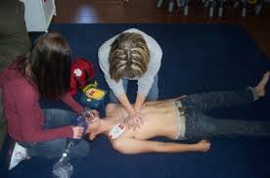
Rotating CPR Operators
CPR can be very tiring, especially chest compressions, and as a result the quality of the compressions can get worse and be less effective over time as the first aider becomes tired.
Notes:
You should try to make the changeover as quickly as possible. This can be achieved in a number of ways:
Have the people rotating compressions on opposite sides of the casualty – One can be ready and waiting to swap as soon and the one doing the compressions stops.
Make the swap during other interruptions – for example, when the AED is being administered.
Have someone counting out loud or counting down to when the changeover should occur – everyone will know when it is to happen and be in position at the right time.

Slide 54
Rotating CPR Operators
Try to make the changeover as quickly as possible.
If rotations are more frequent the effectiveness of the CPR can be reduced due to the interruptions.
Have the people rotating compressions on opposite sides of the casualty
Make the swap during other interruptions
Have someone counting out loud or counting down to when the changeover should occur
Notes:
You should try to make the changeover as quickly as possible. This can be achieved in a number of ways:
Have the people rotating compressions on opposite sides of the casualty – One can be ready and waiting to swap as soon and the one doing the compressions stops.
Make the swap during other interruptions – for example, when the AED is being administered.
Have someone counting out loud or counting down to when the changeover should occur – everyone will know when it is to happen and be in position at the right time.

Slide 55
Stopping CPR
You should only stop CPR if:
Emergency response personnel arrive and take over.
You are physically unable to continue.
It is unsafe to do so.
The person shows signs of recovery. In this case move them into the recovery position.
Always keep monitoring the person and be prepared to start CPR again if needed.
Notes:
You should only stop CPR if:
Emergency response services personnel arrive and take over.
You are physically unable to continue.
It is unsafe to do so.
The person starts moving and breathing normally, indicating recovery. In this case move them into the recovery position.
Always keep monitoring the person and be prepared to start CPR again if needed.

Slide 56
CPR
 | Adults & Children | Infants
Head Tilt | Full | None / Neutral
Hand Placement | Centre of Chest | Centre of Chest
Ratio | 30:2 | 30:2
Compression Rates Per Minute | 100-120 | 100-120
Compression Depth | 1/3 depth of chest | 1/3 depth of chest
Technique | 2 Hands | 2 Fingers
Breaths | Breaths | Puffs
Notes:
You should only stop CPR if:
Emergency response services personnel arrive and take over.
You are physically unable to continue.
It is unsafe to do so.
The person starts moving and breathing normally, indicating recovery. In this case move them into the recovery position.
Always keep monitoring the person and be prepared to start CPR again if needed.

Slide 57
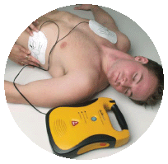
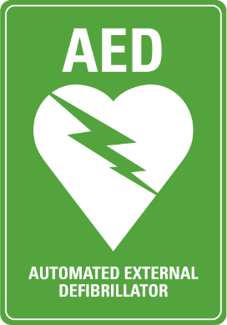
D R S A B C D – Defibrillator
Wipe the casualty’s chest dry if necessary
Attach the pads directly to the skin
The AED detects an abnormal heart rhythm and sends a small electrical charge through the heart
Continue CPR for a further 2 minutes after the shock, leaving the AED attached
Follow the audio prompts
Notes:
CPR should not be stopped until ambulance personnel or an AED (Automated External Defibrillator) arrives.
An AED is an electronic device that is portable, easy to operate, and used when the casualty is having a Sudden Cardiac Arrest (SCA). When the machine detects an abnormal heart rhythm, an electrical shock is sent to the heart, which can restore normal heart rhythm. People who need CPR have abnormal heart rhythms.
Attach an AED if available and follow the instructions. You will find the instructions either in the booklet that comes with the AED or on the screen of the unit.
AEDs are easy to use so you don’t need formal training.
Most have visual and/or verbal instructions that you should follow as different machines may vary slightly.

Slide 58
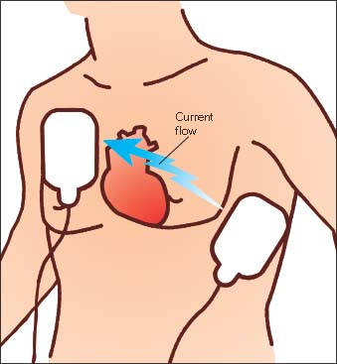
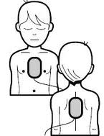
D R S A B C D – Defibrillator
Notes:
CPR should not be stopped until ambulance personnel or an AED (Automated External Defibrillator) arrives.
An AED is an electronic device that is portable, easy to operate, and used when the casualty is having a Sudden Cardiac Arrest (SCA). When the machine detects an abnormal heart rhythm, an electrical shock is sent to the heart, which can restore normal heart rhythm. People who need CPR have abnormal heart rhythms.
Attach an AED if available and follow the instructions. You will find the instructions either in the booklet that comes with the AED or on the screen of the unit.
AEDs are easy to use so you don’t need formal training.
Most have visual and/or verbal instructions that you should follow as different machines may vary slightly.

Slide 59
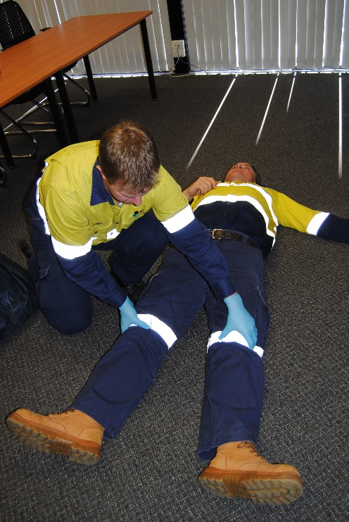
Secondary Survey
A secondary survey involves carefully checking the casualty from head to toe and is done if the initial assessment found no life-threatening conditions.
It assesses the casualty more closely for signs such as:
Cuts.
Burns.
Bleeding.
Bruising and swelling.
Puncture wounds.
Anything out of place.
Notes:
A secondary survey is done if the initial assessment found no life-threatening conditions.
It assesses the casualty more closely for signs such as cuts, burns, bruising, swelling, puncture wounds and anything out of place (misuse of drugs).
It involves carefully checking the casualty from head to toe.

Slide 60
Reassure the Casualty
The casualty could be anxious, agitated and in a lot of pain so you need to be calm, respectful and comforting.
Make a personal introduction.
Show empathy.
Maintain constant communication.
Adopt a caring voice tone and volume.
Offer reassurance and provide gentle treatment.
Notes:
The casualty could be anxious, agitated and in a lot of pain so you need to be calm, respectful and comforting.
To reassure the casualty you should:
Make a personal introduction.
Show empathy.
Maintain constant communication with the casualty.
Adopt a caring voice tone and volume.
Offer reassurance and gentle treatment in a culturally appropriate manner.

Slide 61
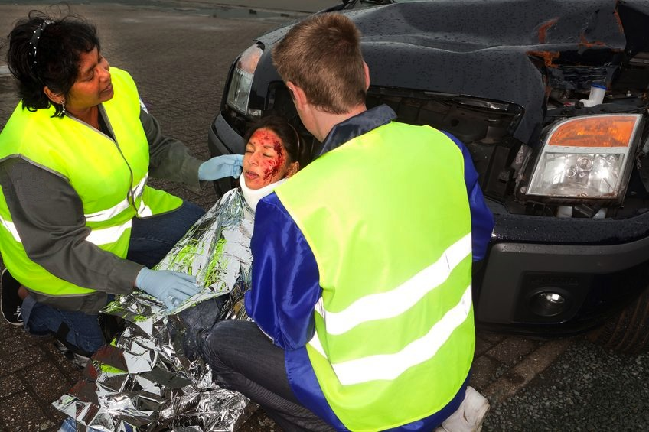
Make the Casualty Comfortable
You need to make the casualty as comfortable as you can until emergency services arrive.
This could mean moving them to a sheltered place out of the elements
Use coats, thermal blankets or other things to maintain body temperature
If there is a head injury, support their head and neck with a pillow or padding
Notes:
You need to make the casualty as comfortable as you can until emergency services arrive.
This could mean moving them to a sheltered place out of the sun, rain, wind or cold.
You could use coats, blankets or other things to keep them warm or shaded.
If there is a head injury you could support their head and neck with a pillow or some other sort of padding.

Slide 62
Triage
If it is a major incident and there are a lot of casualties to treat, you need to prioritise treatment.
This process is called ‘triage’.
Triage means deciding who to help first.
It comes from a French term for separate or select.
Start with the casualties with the worst injuries and based on their level of consciousness.
Colours are used to identify priorities
Notes:
If it is a major incident and there are a lot of casualties to treat, you need to prioritise treatment. Start with the casualties with the worst injuries.
This process is called ‘triage’.
Triage means deciding who to help first. This will give the most people the best chance of surviving the incident.

Slide 63
Triage
Highest priority
RED casualties who need immediate first aid for survival
YELLOW casualties that can be stabilised and monitored
GREEN casualties with less critical injuries that can move
WHITE casualties that don’t need first aid
BLACK deceased casualties
Lowest priority
Notes:
If it is a major incident and there are a lot of casualties to treat, you need to prioritise treatment. Start with the casualties with the worst injuries.
This process is called ‘triage’.
Triage means deciding who to help first. This will give the most people the best chance of surviving the incident.

Slide 64
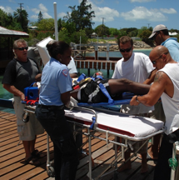
Use Safe Manual Handling Techniques
You may need to move a casualty away from hazards or to make it easier to give treatment.
Moving a person into the recovery position can also be difficult.
Check with the casualty to make sure they are comfortable about being moved.
Explain what you are going to do.
Make sure you don’t hurt yourself or the patient – use safe manual handling techniques.
Use your legs, keep your back straight and work closely to the casualty
Notes:
You may need to move a casualty away from hazards in the area or to make it easier to get to them for treatment.
First, check with the casualty to make sure they are comfortable about being moved and explain what you are going to do.
To make sure you don’t hurt yourself or the patient you should use techniques for safe manual handling.
You should always bend your knees and not your back when lifting. This will help to avoid straining your back.

Slide 65
Shock
Shock can be life-threatening and occurs when the body is unable to cope with serious injuries.
When a person goes into shock the body sends oxygenated blood to the vital organs first.
Blood flow slows to the limbs and digestive system (pale, cold, sweaty skin and nausea).
After time the tissues of the arms and legs will begin to die.
At this stage the brain will return blood flow to these parts, causing vital organs to lose blood flow.
Notes:
Shock can be life-threatening and occurs when the body is unable to cope with serious injuries, illnesses or stressful situations e.g. bleeding, burns, severe allergic reactions, witnessing an accident.
When a person goes into shock the body sends oxygen/blood to the vital organs first. This slows the blood flow to the limbs and digestive system, causing pale, cold, sweaty skin and nausea.
After a time the tissues of the arms and legs will begin to die. At this stage the brain will return blood flow to these parts, causing vital organs to lose blood flow. If this continues the person will become drowsy, and the heart and lungs will begin to shut down, resulting in death.

Slide 66
Shock
Recognising shock:
Cold, pale, sweaty skin.
Rapid, weak pulse.
Rapid breathing.
Feeling anxious, restless and very thirsty.
May develop nausea/vomiting.
Altered conscious state.
Notes:
Recognising shock:
Cold, pale, sweaty skin.
Rapid, weak pulse.
Rapid breathing.
Casualty may feel anxious, restless and very thirsty.
Casualty may develop nausea/vomiting.
Altered conscious state.

Slide 67
Notes:
If the Patient is Conscious:
1. Prevent further injury.
2. Assess the patient and provide first aid for major injury/illness.
3. Manage any other injuries e.g. fractures, bleeding.
4. Make the person comfortable and cover with a blanket to maintain body temperature.
5. DO NOT give the patient any food or drink. If needed moisten their lips to make them more comfortable.
6. Call for an ambulance – Dial 000 or 112 for help.
7. Continue to monitor ABC (Airway, Breathing, Circulation) and consciousness/responses.
8. If the person becomes unconscious move them to the recovery position and monitor ABC.

Slide 68
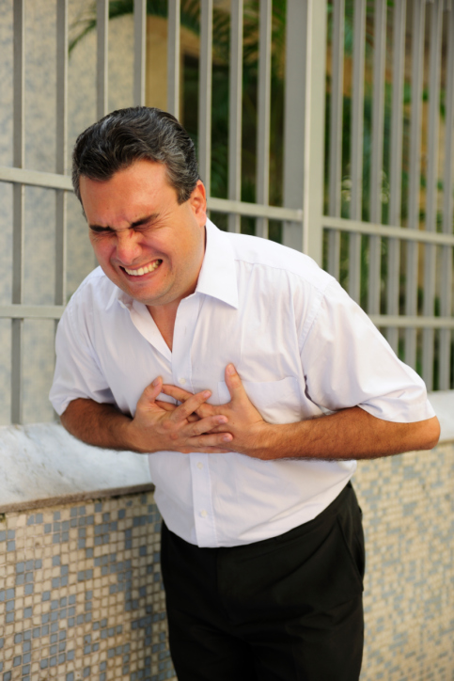
Chest Pain
Chest pain may be a sign of a cardiac emergency.
Recognising chest pain:
Sudden onset of tight, heavy or dull pain/ache across the chest.
Pain can spread to the neck, jaw, shoulders or arms.
May develop nausea, vomiting, shortness of breath, dizziness or light-headedness.
Notes:
Chest pain may be a sign of a cardiac emergency. Recognising chest pain:
Sudden onset of tight/heavy or dull pain or ache across the chest.
Pain can spread to the neck, jaw, shoulders or arms (usually the left arm).
May develop nausea, vomiting, shortness of breath, dizziness or light-headedness.

Slide 69
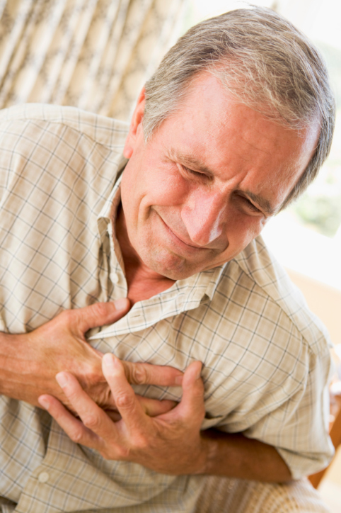
Chest Pain
Common conditions associated with chest pain:
Sudden cardiac arrest.
Heart attack.
Angina.
Congestive heart failure.
Notes:
Common conditions associated with chest pain are:
Sudden cardiac arrest.
Heart attack.
Angina.
Congestive heart failure.

Slide 70
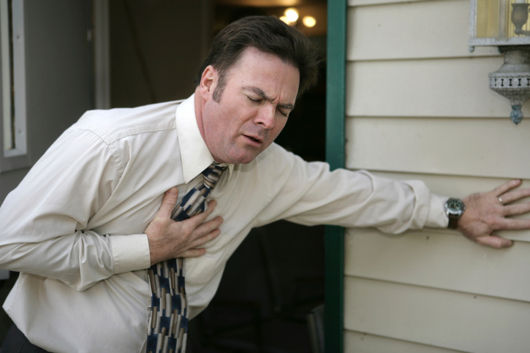
Heart Attack
A heart attack occurs when heart tissue dies.
A person experiencing a heart attack will still be conscious and have a pulse. However, if it is not treated it may lead to sudden cardiac arrest.
Notes:
A heart attack occurs when heart tissue dies and is often linked to cardiovascular disease.
This is where fatty deposits have built up in the inner walls of the coronary arteries, causing a blood clot/s to form and slowing blood flow to the heart.
A person who is experiencing a heart attack will still be conscious and have a pulse. However, if the heart attack is not treated it may lead to sudden cardiac arrest.

Slide 71
If the Patient is Conscious:
Help the patient rest and give reassurance. Assist with any prescribed medication. Monitor vital signs. Call for an ambulance – Dial 000 or 112. Be prepared to perform CPR if the patient becomes unconscious and loses vital signs.
If the Patient is Unconscious:
Commence DRS ABCD Emergency Action Plan. Call an ambulance on 000 or 112.
Notes:
If the Patient is Conscious:
1. Help the patient rest and give reassurance.
2. Assist with any prescribed medication.
3. Monitor vital signs.
4. Call for an ambulance – Dial 000 or 112.
5. Be prepared to perform CPR if the patient becomes unconscious and loses vital signs.
If the Patient is Unconscious:
1. Commence DRS ABCD Emergency Action Plan.
2. Call an ambulance on 000 or 112.

Slide 72
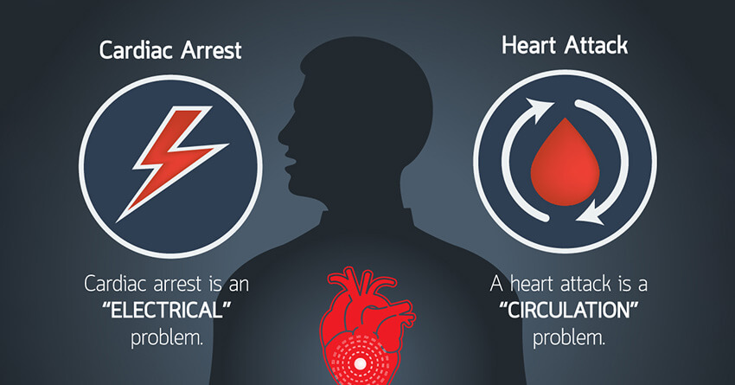
Sudden Cardiac Arrest
When a heart attack is not promptly controlled and treated, it can get worse and turn into a sudden cardiac arrest and loss of vital signs.
It is vital that DRS ABCD and the chain of survival are started as soon as possible.
Notes:
When a heart attack is not promptly controlled and treated, it can get worse and turn into a sudden cardiac arrest with a loss of vital signs.
In cases of sudden cardiac arrest the heart stops beating or does not beat regularly enough to circulate blood properly. Unconsciousness occurs and breathing will stop. If nothing is done the person will die. It is vital that DRS ABCD and the chain of survival are started as soon as possible.

Slide 73
Sudden Cardiac Arrest
You can recognise signs of cardiac arrest when the casualty:
Is unconscious.
Has no signs of life.
Will not respond to touch.
Will not respond to questions.
Is not breathing normally.
Has no pulse rate.
Notes:
You can recognise signs of cardiac arrest when the casualty:
Is unconscious.
Has no signs of life.
Will not respond to touch.
Will not respond to questions.
Is not breathing normally.
Has no pulse rate.

Slide 74
Sudden Cardiac Arrest
Treatment if the patient is unconscious:
Commence DRS ABCD Basic Life Support.
Clear the airways and commence CPR, attach an AED if available and follow the instructions or on-screen directions of the unit.
Call for an ambulance.
Notes:
Treatment if the patient is unconscious:
1. Commence DRS ABCD Basic Life Support.
2. Clear the airways and commence CPR, attach an AED if available and follow the instructions or on-screen directions of the unit.
3. Call 000 or 112 for an ambulance.

Slide 75
The Chain of Survival
Quick action can save lives!
If each link in the chain of survival is carried out as soon as possible survival rates can be 20-30% higher.
The 4 links in the chain of survival are:
Notes:
The chain of survival is the rapid administration of CPR in sudden cardiac arrest situations to maximize its life saving potential. Understanding the links in the chain of survival can improve the chances of survival from a cardiac arrest.
The 6 links in the chain of survival are:
Early recognition.
Early access.
Early CPR.
Early defibrillation.
Early advanced life support.
Early definitive care.

Slide 76
Angina
Angina can look like a heart attack but the chest pain can come and go in less than 10 minutes. A person will still be conscious and have a pulse but it must be treated or it may lead to sudden cardiac arrest.
Prescribed medication can relieve the condition.
Recognising angina:
A tight/heavy or dull pain/ache starts across the chest and comes and goes.
Pain can spread to the neck, jaw, shoulders or arms (usually the left arm).
The person may develop nausea, shortness of breath and look pale, distressed.
Notes:
Angina can look like a heart attack but the chest pain can come and go and last less than 10 minutes. It will often occur during physical exercise.
A person with angina will still be conscious and have a pulse but it must be treated or it may lead to sudden cardiac arrest.
People who have been diagnosed with angina should have prescribed medication with them to relieve the condition.
Recognising angina (similar symptoms to a heart attack):
A tight/heavy or dull pain or ache starts across the chest and comes and goes at different times.
Pain can spread to the neck, jaw, shoulders or arms (usually the left arm).
The person may develop nausea, vomiting, shortness of breath and they usually look pale, distressed.

Slide 77
If the Patient is Conscious:
Ensure the person stops physical activity/exertion. Rest the patient in a comfortable position and give reassurance. Help the patient to ‘self-administer’ their prescribed angina medication. Be prepared as the patient may become unconscious. If medication does not work and there has been no relief after 10 minutes, call for an ambulance – Dial 000 or 112.
If the Patient is Unconscious:
Commence DRS ABCD Basic Life Support. Call an ambulance on 000 or 112.
Notes:
Treatment includes:
If the Patient is Conscious:
1. Ensure the person stops physical activity/exertion.
2. Rest the patient in a comfortable position and give reassurance.
3. Help the patient to ‘self-administer’ their prescribed angina medication.
4. Be prepared as the patient may become unconscious.
5. If medication does not work and there has been no relief after 10 minutes, call for an ambulance – Dial 000 or 112.
If the Patient is Unconscious:
1. Commence DRS ABCD Emergency Action Plan.
2. Call an ambulance on 000 or 112.

Slide 78
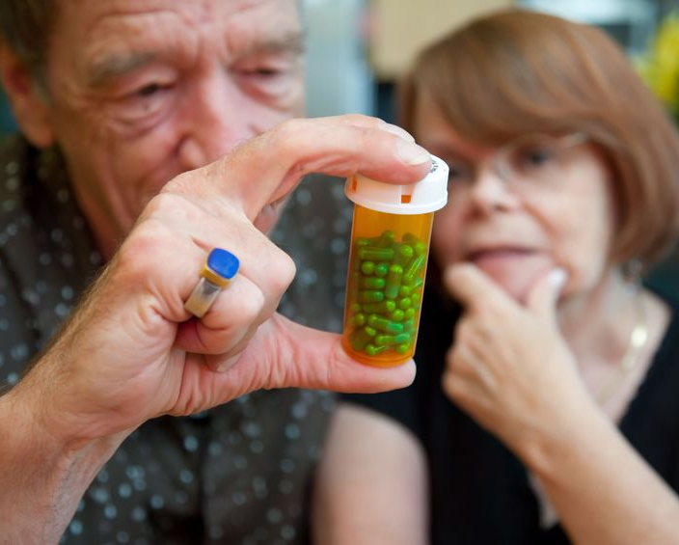
Congestive Heart Failure
Congestive heart failure is when the heart is weak, doesn’t function well and can’t pump normally.
A person who is experiencing congestive heart failure will still be conscious and have a pulse.
If it is not treated, the person could have a sudden cardiac arrest.
Notes:
Congestive heart failure describes when the heart is weak, doesn’t function well and can’t pump normally. It is usually due to old age or chronic heart disease.
A person with congestive heart failure may be well for most of the time but they can suddenly get worse particularly when they get sick or don’t take prescribed medications.
A person who is experiencing congestive heart failure will still be conscious and have a pulse. If it is not treated, the person could have a sudden cardiac arrest.

Slide 79
Congestive Heart Failure
Recognising congestive heart failure:
Breathing difficulties – coughing, wheezing (sometimes gurgling sounds).
Swollen feet, ankles, legs, and abdomen.
General tiredness and breathlessness.
General feeling of ill health.
Notes:
Recognising congestive heart failure:
Breathing difficulties – coughing, wheezing, sometimes with gurgling sounds.
Swollen feet, ankles, legs, and abdomen.
During exercise – general tiredness and breathlessness. May also occur during times of strong emotion.
General feeling of ill health.

Slide 80
If the Patient is Conscious:
Ensure the person stops physical activity/exertion. Rest the patient in a comfortable position and give reassurance. Help the patient to ‘self-administer’ their prescribed medication. If their condition gets worse: Call for an ambulance – Dial 000 or 112. Monitor vital signs often – Record the breathing and pulse rates for handover to emergency personnel. Be prepared to perform CPR if the patient becomes unconscious and loses vital signs.
If the Patient is Unconscious:
Commence DRS ABCD Basic Life Support. Call an ambulance on 000 or 112.
Notes:
Treatment includes:
If the Patient is Conscious:
1. Ensure the person stops physical activity/exertion.
2. Rest the patient in a comfortable position and give reassurance.
3. Help the patient to ‘self-administer’ their prescribed medication.
If their condition is getting worse:
4. Call for an ambulance – Dial 000 or 112.
5. Monitor vital signs often – record the breathing and pulse rates for handover to emergency personnel.
6. Be prepared to perform CPR if the patient becomes unconscious and loses vital signs.
If the Patient is Unconscious:
1. Commence DRS ABCD Emergency Action Plan.
2. Call an ambulance on 000 or 112.

Slide 81
Drowning
If possible use an item that floats to help get the person out of the water.
Check first that it is safe to do so and then:
Have someone call for an ambulance.
Get the person out of the water using a flotation device if available.
When the casualty is out of the water immediately turn them on to one side, open the airway to drain any water or vomit.
Follow the Emergency Action Plan DRSABCD.
If no signs of life are present immediately start CPR.
Continue with CPR until emergency services personnel arrive.
Notes:
A drowning person can have a cardiac arrest and die. You could put your life in danger by trying to rescue the casualty from the water. If possible use an item that floats to help get the person out of the water.

Slide 82
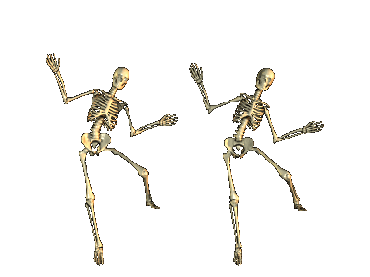
Skeletal Injuries
Often if there have been injuries to the skeletal system then injuries to the muscles, ligaments and tendons will also be present, and vice-versa.
Notes:
There are various injuries that may affect the skeletal system. Often if there have been injuries to the skeletal system then injuries to the muscles, ligaments and tendons will also be present, and vice-versa.

Slide 83
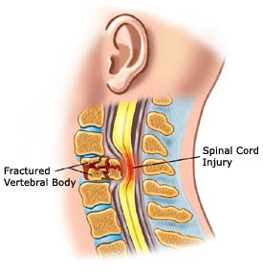
Head, Neck and Spinal Injuries
You should always be aware of the potential for damage to the spinal cord.
Head, neck and spinal injuries can often damage both bones and soft tissue.
You should always treat the injury as serious.
Possible head, neck and spinal damage can occur in nearly any situation but particularly where there has been serious impact.
Notes:
In providing first aid management you should always be aware of the potential for damage to the spinal cord, which is the nerve centre for controlling movement.
Head, neck and spinal injuries can often damage both bones and soft tissue, which can include the brain and spinal cord.
As these injuries can become deadly quickly and they can only be assessed and diagnosed fully through x-ray, you should always treat the injury as very serious.
Possible head, neck and spinal damage can occur in nearly any situation but particularly where there has been serious impact, such as in a car accident or a fall from some height.

Slide 84
Head, Neck and Spinal Injuries
Common warning signs of head, neck or spinal injuries:
Changes in state of consciousness.
Seizures.
Severe pain/pressure in the head, neck or back.
Large volume of bleeding in the head, neck or back.
Tingling, pins and needles or numbness in the extremities.
Partial or complete loss of movement in any body part.
Discharges or presence of blood or other fluids in the ears or nose.
Notes:
Some common warning signs of head, neck or spinal injuries may include:
Changes in the person’s state of consciousness.
Seizures.
Severe pain/pressure in the head, neck or back.
Large volume of bleeding in the head, neck or back.
Tingling, pins and needles or numbness in the extremities (hands and feet).
Partial or complete loss of movement in any body part.
Discharges or presence of blood or other fluids in the ears or nose.
Continued…

Slide 85
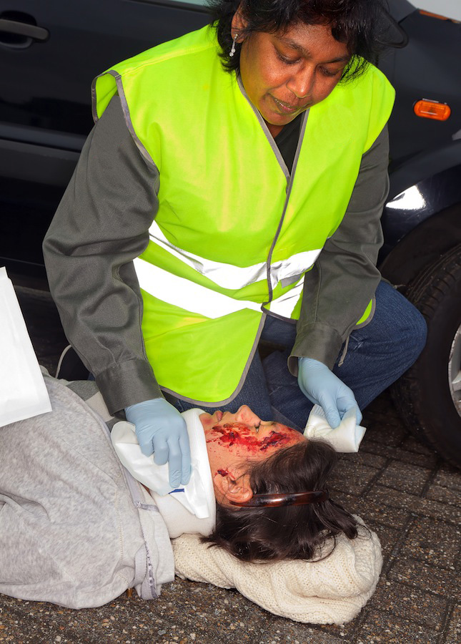
Head, Neck and Spinal Injuries
Bruising on the head, particularly around eyes or behind ears.
Nausea/vomiting.
Impaired/difficulty breathing.
Vision problems.
Persistent headache.
Loss of balance.
Unusual bumps/depressions on the head and/or spine.
Head, neck and spinal injuries can result in paraplegia or quadriplegia and can also be potentially life-threatening.
Notes:
Continued…
Bruising on the head, particularly around the eyes or behind ears.
Nausea or vomiting.
Impaired/difficulty breathing.
Vision problems.
Persistent headache.
Loss of balance.
Unusual bumps/depressions on the head and/or spine.
Head, neck and spinal injuries can result in paraplegia or quadriplegia, depending on the location of the injury. They can also be potentially life-threatening as breathing can stop.

Slide 86
Head, Neck and Spinal Injuries
Notes:
Some general treatment guidelines are:
If the Patient is Conscious:
1. Reassure the patient and get them to stay still.
2. Call an ambulance on 000 or 112.
3. Continually monitor vital signs.
4. Minimise any movement of the head/neck/spine.
5. Manage any other injuries.
6. Maintain body temperature.
If the Patient is Unconscious:
1. Commence DRS ABCD Basic Life Support.
2. If unconscious and airways need to be cleared carefully turn the person on their side without twisting, bending or moving the person’s neck and back too much. If another person is able to help, one of you should move the body while the other supports the head, neck and spine.

Slide 87
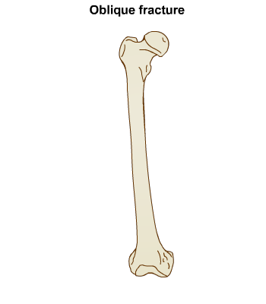
Fractures and Breaks
Fractures are breaks in bone tissue and can be classed as either open or closed.
Open fractures involve an open wound – the limb may be severely bent or an object may have penetrated the skin.
Closed fractures have no broken skin and are more common.
Fractures can become life-threatening if there is severe internal or external bleeding and the risk of shock.
Notes:
Fractures are breaks in bone tissue and can be classed as either open or closed fractures.
Open fractures involve an open wound – both sides of the fracture do not need to be visible. The limb may be severely bent or an object may have penetrated the skin, breaking the bone.
Closed fractures have no broken skin and are more common than open fractures.
Fractures can become life-threatening if there is severe internal or external bleeding and because of the risk of shock. If organs or major nerves or other structures/systems are also injured, the fracture, whether open or closed, is classed as ‘complicated’.

Slide 88
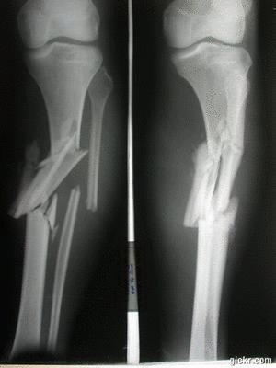
Fractures and Breaks
Common signs and symptoms include:
Pain/tenderness.
Deformity or abnormal position/twist of limb.
Swelling.
Loss of function.
Discolouration and bruising.
Shock.
Notes:
Common signs and symptoms include:
Pain/tenderness – at or near the injury site.
Deformity or abnormal position/twist of limb.
Swelling.
Loss of function.
Discolouration, bruising of skin.
Shock.
Fractures/breaks are usually checked for as part of the secondary survey, unless the casualty is in life-threatening danger from loss of blood from an open fracture.

Slide 89
Notes:
General first aid treatment may include:
If the Patient is Conscious:
1. Control any bleeding and cover any wounds.
2. Check for signs of fractures.
3. Ask the casualty not to move the injured body part.
4. Immobilise and/or support the fracture.
5. Handle gently – move the limb/body part as little as possible to prevent making the fracture worse (e.g. a closed fracture may become an open fracture) and to lessen the person’s pain.
6. Seek medical aid.
If the Patient is Unconscious:
1. Commence DRS ABCD Emergency Action Plan.
2. Call an ambulance on 000 or 112.

Slide 90
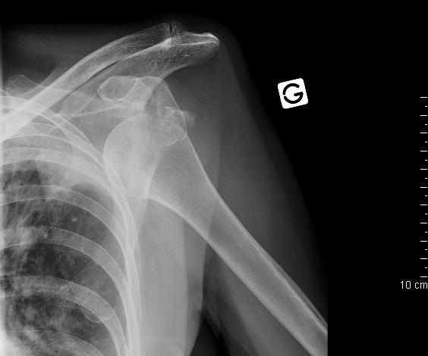
Dislocations
Dislocations occur when a bone is separated or displaced from its normal joint position.
Left untreated, they may lead to a permanent loss of function in the affected area.
Do not try to put the joint back in place - this should be done by a qualified medical professional.
Notes:
Dislocations occur when a bone is separated or displaced from its normal joint position. If left untreated dislocations may lead to a permanent loss of function in the affected area.
Do not try to put the joint back in place; this should be done by a qualified medical professional, as more damage may be caused to the joint and nerves if done incorrectly.

Slide 91
If the Patient is Conscious:
Complete primary and secondary surveys. Support and immobilise the injury. Treat for shock. Apply a cold compress/ice pack to the affected area to help alleviate pain and swelling. Place the person in a comfortable position. Seek professional medical help.
If the Patient is Unconscious:
Commence DRS ABCD Basic Life Support. Call an ambulance on 000 or 112.
Notes:
First aid treatment may include:
If the Patient is Conscious:
1. Complete primary and secondary surveys.
2. Support and immobilise the injury.
3. Treat for shock.
4. Apply a cold compress/ice pack to the affected area to help alleviate pain and swelling.
5. Place the person in a comfortable position.
6. Seek professional medical help.
If the Patient is Unconscious:
1. Commence DRS ABCD Emergency Action Plan.
2. Call an ambulance on 000 or 112.

Slide 92
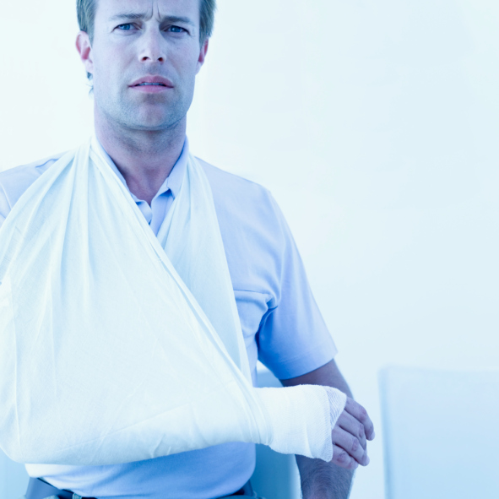
Immobilisation/Slinging
A splint is anything used to support and/or immobilise a fracture or dislocation.
Immobilisation techniques:
Supporting the injury by packing available material around it.
Applying a splint.
Soft splints.
Rigid splints.
Body splints.
Notes:
A key part of first aid treatment for skeletal injuries is splinting. A splint is anything used to support and/or immobilise a fracture or dislocation.
Immobilisation techniques may include:
Supporting the injury where it is found by packing available material around it, e.g. blankets, clothing. This allows the person to relax their muscles and helps to relieve/reduce pain.
Applying a splint. Splints may be soft, rigid or body splints, and may be improvised or a commercial product.
Soft splints include towels, cushions or folded blankets along with bandages/slings.
Rigid splints include metal strips, boards, folded magazines and papers along with bandages/slings.
Body splints involve securing an injured body part to another body part, e.g. an injured arm being secured to the chest or securing an injured leg to the uninjured one. Also requires slings/bandages or other material to secure the injured body part.

Slide 93
Immobilisation/Slinging
Points to remember:
Apply the splint in the position in which you found the limb.
Immobilise the limb above and below the joints closest to the injury site.
Check the circulation both before and after applying the splint.
Check the person’s ABC.
Help the person to get comfortable and offer reassurance.
Maintain their body temperature.
Continue to monitor vital signs and check for shock.
Notes:
Points to remember when supporting/slinging injuries:
1. Apply the splint in the position in which you found the limb.
2. When splinting, immobilise the limb above and below the joints closest to the injury site.
3. Check the circulation both before and after applying the splint.
4. After splinting check the person’s airway, breathing and circulation.
5. Help the person to rest in the position most comfortable for them and offer reassurance.
6. Maintain their body temperature.
7. Continue to monitor vital signs and check for signs of shock.
Only splint if necessary and if it can be done without causing more pain/discomfort for the individual.

Slide 94
Common Body Splint/Slinging Techniques
Notes:
Some of the most common body splinting techniques are those for the arm, which are outlined in the table below.
Arm Sling
Used for injuries to the arm or hand.
Also used for some chest injuries.
Holds the forearm across the chest.

Slide 95
Common Body Splint/Slinging Techniques
Notes:
Elevation Sling
Used when there is bleeding from the hand.
Also used when chest or shoulder injuries are present.
Supports the forearm and hand in a higher position than the arm sling.
DO NOT use for elbow injuries.

Slide 96
Common Body Splint/Slinging Techniques
Notes:
Collar and Cuff Sling
Uses a clove hitch so that the circulation is not cut off.
Used when pressure should not be applied to the elbow.
Supports the upper arm.
Provides passive traction for fractures halfway along the humerus shaft.

Slide 97
Altered Consciousness
If a person is unconscious or has an altered state of consciousness then it is a sign that something is wrong in the body.
Unconsciousness includes:
Blood circulation problems.
Blood oxygenation problems.
Metabolic problems.
Central nervous system problems.
Notes:
If a person is unconscious or has an altered state of consciousness then it is a sign that something is wrong in the body. The ARC Guideline (3) identifies the causes of unconsciousness as:
Blood circulation problems.
Blood oxygenation problems.
Metabolic problems (e.g. diabetes, overdoses).
Central nervous system problems (e.g. head injury, stroke, tumour, epilepsy).

Slide 98
Head Injuries
It may not always be obvious that a person has a head injury. They can result in injury to the brain.
If you think a person has a head injury you need to watch them closely and regularly for signs of changes in their conscious state.
Spinal injuries may also be present so care should be taken if moving the person.
All head injuries should be considered serious.
Notes:
It may not always be obvious that a person has a head injury, you might not see bleeding or bruising.
Head injuries can result in injury to the brain and may be caused by direct impact to the head or as a result of other actions/incidents such as whiplash or falling heavily on the feet.
If you think a person has a head injury you need to watch them closely and regularly for signs of changes in their conscious state and take appropriate action.
Spinal injuries may also be associated with the head injury so care should be taken if moving the person.
All head injuries should be considered serious.

Slide 99
Concussion
Common signs and symptoms of concussion
Headache.
Nausea/vomiting.
Confusion/temporary short-term memory loss.
Unconsciousness – for brief or extended periods.
“Seeing stars”, blurred or double vision.
Dizziness, stumbling, lack of coordination.
Numbness/tingling/weakness/pins and needles in arms and legs.
Notes:
Common signs and symptoms include:
Headache.
Nausea/vomiting.
Confusion/temporary short-term memory loss.
Unconsciousness – for brief or extended periods.
“Seeing stars”, blurred or double vision.
Dizziness, stumbling, lack of coordination.
Numbness/tingling/weakness/pins and needles in arms and legs.

Slide 100
Assess level of consciousness – talk and touch method. Then:
If the Patient is Conscious:
Observe closely and note changes in condition – improvement/deterioration. Conduct secondary survey. Carry out any required first aid. Person should see a doctor at earliest possible time.
If the Patient is Unconscious:
Commence DRS ABCD Basic Life Support. Call an ambulance on 000 or 112.
Notes:
For someone you think has concussion get medical help and watch them closely.
Immediate first aid management involves:
1. Assess level of consciousness – talk and touch method. Then:
If the Patient is Conscious:
2. Observe closely and note changes in condition – improvement/deterioration.
3. Conduct secondary survey.
4. Carry out any required first aid.
5. Person should see a doctor at earliest possible time.
If the Patient is Unconscious:
2. Commence DRS ABCD Basic Life Support.
3. Call an ambulance on 000 or 112.

Slide 101
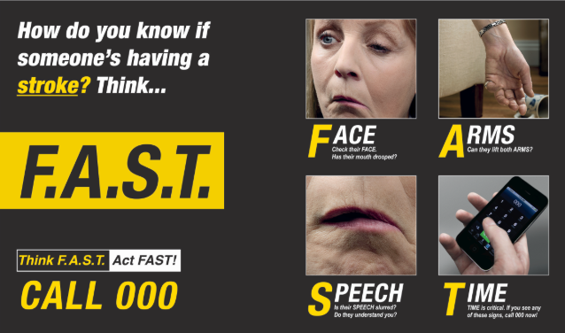
Stroke
A stroke happens when blood flow to the brain is disrupted and brain tissue is damaged due to bleeding/blood clot.
The most common method for checking for a stroke is using the FAST method.
F – Facial weakness.
A – Arm weakness.
S – Speech.
T – Time to act fast.
Notes:
A stroke happens when blood flow to the brain is disrupted and brain tissue is damaged due to bleeding or a blood clot.
The most common method for checking for a stroke is using the FAST method.
F – Facial weakness – Can the person smile? Does the mouth or eye droop?
A – Arm weakness – Can the person raise both arms?
S – Speech – Is the speech slurred? Can the person understand what you say?
T – Time to act fast – Call an ambulance (000 or 112).

Slide 102
Stroke
Common signs and symptoms include:
Sudden weakness/numbness/paralysis of one side of the face, arm or leg.
Sudden difficulty swallowing.
Blurred/decreased vision.
Severe sudden headache.
May develop nausea, vomiting and drowsiness.
May develop dizziness, fatigue or become unconscious.
Notes:
Other common signs and symptoms include:
Sudden weakness/numbness/paralysis of one side of the face, arm or leg.
Sudden difficulty swallowing.
Blurred/decreased vision.
Severe sudden headache.
May develop nausea, vomiting and drowsiness.
May develop dizziness, fatigue or become unconscious.

Slide 103
If the Patient is Conscious:
If you haven’t already done so call an ambulance on 000 or 112. Conduct secondary survey. Carry out any required first aid. Help the person rest comfortably – the head and shoulders should be higher than the rest of the body. Reassure the person to help relieve anxiety. DO NOT give the casualty anything to eat OR drink. If the person is drooling or has difficulty swallowing move them into the recovery position on the side with the facial droop facing down/closest to the ground.
Notes:
You don’t have much time so call an ambulance straight away.
If the Patient is Conscious:
1. If you haven’t already done so call an ambulance on 000 or 112.
2. Conduct secondary survey.
3. Carry out any required first aid.
4. Help the person rest comfortably – the head and shoulders should be higher than the rest of the body.
5. Reassure the person to help relieve anxiety.
6. DO NOT give the casualty anything to eat OR drink.
7. If the person is drooling or has difficulty swallowing move them into the recovery position on the side with the facial droop facing down/closest to the ground.

Slide 104
Stroke
If the Patient is Drowsy or Unconscious:
Commence DRS ABCD Basic Life Support. Call an ambulance on 000 or 112. Move them into the recovery position on the side with the facial droop facing down/closest to the ground. Care for any life-threatening illnesses/injuries. Continue to monitor vital signs until the ambulance arrives.
Notes:
If the Patient is Drowsy or Unconscious:
1. Commence DRS ABCD Basic Life Support.
2. Call an ambulance on 000 or 112.
3. Move them into the recovery position on the side with the facial droop facing down/closest to the ground.
4. Care for any life-threatening illnesses/injuries.
5. Continue to monitor vital signs until the ambulance arrives.

Slide 105
Seizures
Seizures occur when the electrical activity of the brain is interrupted or becomes irregular.
This may be caused by:
Stroke.
Poisoning.
Head injury.
Meningitis.
Brain tumour.
Fever/infection.
Epilepsy.
Febrile convulsions.
Notes:
Seizures occur when the electrical activity of the brain is interrupted or becomes irregular. This may be caused by a number of conditions and injuries including:
Stroke.
Poisoning.
Head injury.
Meningitis.
Brain tumour.
Fever/infection.
Epilepsy.
Infantile/Febrile convulsions (in children only).

Slide 106
Seizures
Seizures can vary in their appearance.
Some people may appear to “tune out” for a short time and be unresponsive.
Others have sudden, muscular contractions, called convulsions.
Seizures can look scary but you need to stay calm and keep the person safe.
Notes:
Seizures occur when the electrical activity of the brain is interrupted or becomes irregular. This may be caused by a number of conditions and injuries including:
Stroke.
Poisoning.
Head injury.
Meningitis.
Brain tumour.
Fever/infection.
Epilepsy.
Infantile/Febrile convulsions (in children only).

Slide 107
During the Seizure:
DO NOT try to stop the seizure. DO NOT try to restrain/hold the person – this could result in other injuries. Make the area around the person safe – remove objects, furniture away from the person. Protect the person’s head – use a low pillow or folded clothing under their head. DO NOT place anything in the person’s mouth/between their teeth – they will not swallow their tongue.
Notes:
First aid management may include:
During the Seizure:
1. DO NOT try to stop the seizure.
2. DO NOT try to restrain/hold the person – this could result in other injuries.
3. Make the area around the person safe – remove objects, furniture etc. away form the person.
4. Protect the person’s head – use a low pillow or folded clothing etc. under their head.
5. DO NOT place anything in the person’s mouth/between their teeth – they will not swallow their tongue. (They could bite their tongue or cheek but this shouldn’t cause too much bleeding).

Slide 108
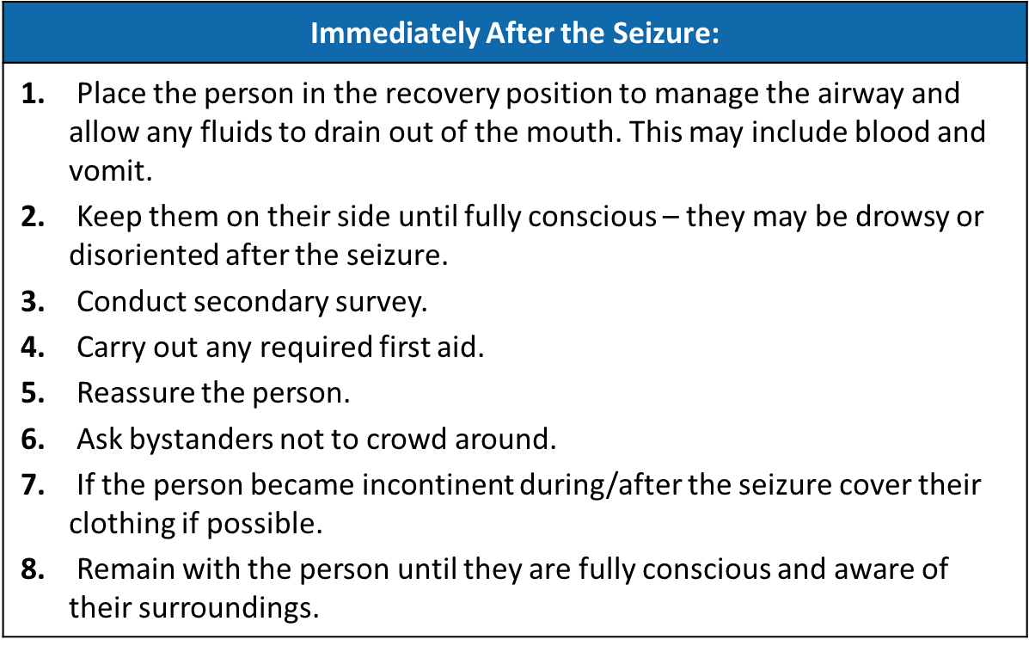
Notes:
Immediately After the Seizure:
1. Place the person in the recovery position to manage the airway and allow any fluids to drain out of the mouth. This may include blood and vomit.
2. Keep them on their side until fully conscious – they may be drowsy or disoriented after the seizure.
3. Conduct secondary survey.
4. Carry out any required first aid.
5. Reassure the person.
6. Ask bystanders not to crowd around.
7. If the person became incontinent during/after the seizure cover their clothing if possible.
8. Remain with the person until they are fully conscious and aware of their surroundings.

Slide 109
Seizures
Call an ambulance if:
It is the first time the person has had a seizure.
It lasts more than a few minutes.
Another seizure/s occurs soon after the first.
The person is pregnant.
The person has diabetes.
The person has difficulty breathing after the convulsions stop.
The person is injured.
It occurs in water.
The person involved is an infant/child.
The person does not regain consciousness.
Notes:
Call an ambulance (000 or 112) if:
It is the first time the person has had a seizure/there is no history of seizures.
The seizure lasts more than a few minutes.
Another seizure/s occurs soon after the first one.
The person is pregnant.
The person has diabetes.
The person has difficulty breathing after the convulsions stop.
The person is injured.
The seizure occurs in water.
The person involved is an infant/child.
The person does not regain consciousness after the seizure.

Slide 110
Febrile Convulsions
Seizures/convulsions in children are called febrile convulsions.
These usually only occur between the ages of 6 months – 6 years.
Common signs and symptoms:
High fever.
Hot, flushed, sweating skin.
General unwell appearance.
Eyes rolling up or squinting.
Body stiffness with arched spine.
Jerking of the limbs/twitching of the face.
Saliva frothing at the mouth.
Difficulty breathing – pale/blue in colour.
Notes:
Seizures/convulsions in children that are brought on by high fever (from any cause) are called febrile convulsions. These usually only occur in children between the ages of approximately 6 months to 6 years. Common signs and symptoms of febrile convulsions are:
High fever.
Hot, flushed, sweating skin.
General unwell appearance.
Eyes rolling up or squinting.
Body stiffness with arched spine.
Jerking of the limbs/twitching of the face.
Saliva frothing at the mouth/difficulty breathing – child may go pale/blue in colour.

Slide 111
During the Seizure:
Remain calm and follow the guidelines as for regular seizures as well as: Undress the child to minimal clothing to help bring down temperature. DO NOT put them in a bath. Monitor body temperature to ensure they do not become chilled. Convulsions should stop as soon as the body temperature is lowered. If possible note the time the convulsions begin and end. If convulsions last more than 5 minutes call an ambulance (000 or 112).
After the Seizure:
Follow the guidelines as for regular seizures. Call a doctor about treatment of the underlying illness.
Notes:
First aid management may include:
During the Seizure:
Remain calm and follow the guidelines as for regular seizures as well as:
1. Undress the child to minimal clothing to help bring down temperature. DO NOT put them in a bath.
2. Monitor body temperature to ensure they do not become chilled.
3. Convulsions should stop as soon as the body temperature is lowered.
4. If possible note the time the convulsions begin and end.
5. If convulsions lasts more than 5 minutes call an ambulance (000 or 112).
After the Seizure:
1. Follow the guidelines as for regular seizures.
2. Call a doctor about treatment of the underlying illness.

Slide 112
DIABETIC EMERGENCIES
If you aren’t sure if the person has low or high sugar, give them something sweet – a lolly or fruit juice.
The patient should always self-administer insulin as an incorrect dose can be fatal.
Notes:
If you aren’t sure if the person has low or high sugar, give them a sweet drink.
The patient should always self-administer insulin as an incorrect dose can be fatal.

Slide 113
Low Blood Sugar/Hypoglycaemia
Too much insulin, not enough sugar, not enough food or too much exercise or alcohol causes hypoglycaemia. It is often the cause of unconsciousness for diabetics.
Common signs and symptoms:
Cold/pale/sweaty skin.
Weak, dizzy or confused.
Shaking/trembling.
Inappropriate/aggressive behaviour – may appear drunk.
May be unconscious.
Notes:
Too much insulin, not enough sugar, not enough food or too much exercise or alcohol causes hypoglycaemia. Hypoglycaemia often starts more quickly than hyperglycaemia and is often the cause of unconsciousness for diabetics.
Common signs and symptoms of low blood sugar include:
Cold/pale/sweaty skin.
Weak, dizzy or confused.
Shaking/trembling.
Inappropriate/aggressive behaviour – may appear drunk.
May be unconscious.

Slide 114
If the Patient is Conscious:
Conduct primary survey. Carry out secondary survey including looking for a Medic Alert tag indicating diabetes. If able to swallow give the person a sweet, non-diet drink or lolly. Diet/sugar substitute drinks do not work, as they do not contain sugar. Observe the person for signs of recovery – this will occur quickly if low blood sugar levels are the cause. If the person does not recover quickly call 000 or 112 for assistance. If quick recovery occurs and once fully conscious the person should have a small meal, such as a sandwich. Advise the person to see their doctor.
Notes:
Treatment includes:
If the Patient is Conscious:
1. Conduct primary survey.
2. Carry out secondary survey including looking for a Medic Alert tag indicating diabetes.
3. If able to swallow give the person a sweet, non-diet drink or lolly. Diet/sugar substitute drinks do not work, as they do not contain sugar.
4. Observe the person for signs of recovery – this will occur quickly if low blood sugar levels are the cause.
5. If the person does not recover quickly call 000 or 112 for assistance.
6. If quick recovery occurs and once fully conscious the person should have a small meal, such as a sandwich.
7. Advise the person to see their doctor.

Slide 115
If the Patient is Unconscious:
Commence DRS ABCD Basic Life Support. Call an ambulance on 000 or 112. DO NOT give anything by mouth. Monitor ABC. Maintain normal body temperature and monitor for signs of shock.
Notes:
If the Patient is Unconscious:
1. Commence DRS ABCD Basic Life Support.
2. Call an ambulance on 000 or 112.
3. DO NOT give anything by mouth.
4. Monitor ABC.
5. Maintain normal body temperature and monitor for signs of shock.

Slide 116
High Blood Sugar/Hyperglycaemia
Hyperglycaemia occurs when there is too much sugar/glucose in the blood and not enough insulin.
This can happen when they miss insulin doses, overeat, don’t exercise and/or are under stress.
Common signs and symptoms:
Drowsiness.
Excessive thirst.
Increase in urine output.
Smell of acetone (nail polish remover) on breath.
May become unconscious.
Notes:
Hyperglycaemia occurs when there is too much sugar/glucose in the blood and not enough insulin.
For people with diabetes, hyperglycaemia can happen when they miss insulin doses, they overeat, don’t exercise and/or are under stress.
Common signs and symptoms of high blood sugar include:
Drowsiness.
Excessive thirst.
Increase in urine output.
Smell of acetone (nail polish remover) on breath.
May become unconscious.

Slide 117
If the Patient is Conscious:
Follow the same treatment as for hypoglycaemia. That is: Conduct primary survey. Carry out secondary survey including looking for a Medic Alert tag indicating diabetes. If able to swallow give the person a sweet, non-diet drink or lolly. Diet/sugar substitute drinks do not work, as they do not contain sugar. Observe the person for signs of recovery. If the person does not recover quickly/within a few minutes call 000 or 112 for assistance. If the person becomes unconscious follow the emergency phone operator’s instructions.
Notes:
Treatment for hyperglycaemia is the same as for hypoglycaemia because if the person already has an excess of sugar (hyperglycaemia) then more in the short term will not harm them. This means that you will not have to try and work out the best treatment option until an ambulance arrives.
If the Patient is Conscious:
Follow the same treatment as for hypoglycaemia. That is:
1. Conduct primary survey.
2. Carry out secondary survey including looking for a Medic Alert tag indicating diabetes.
3. If able to swallow give the person a sweet, non-diet drink or lolly. Diet/sugar substitute drinks do not work, as they do not contain sugar.
4. Observe the person for signs of recovery.
5. If the person does not recover quickly/within a few minutes call 000 or 112 for assistance.
6. If the person becomes unconscious follow the emergency phone operator’s instructions.

Slide 118
If the Patient is Unconscious:
Commence DRS ABCD Basic Life Support. Call an ambulance on 000 or 112. DO NOT give anything by mouth. Monitor ABC. Maintain normal body temperature and monitor for signs of shock.
Notes:
If the Patient is Unconscious:
1. Commence DRS ABCD Basic Life Support.
2. Call an ambulance on 000 or 112.
3. DO NOT give anything by mouth.
4. Monitor ABC.
5. Maintain normal body temperature and monitor for signs of shock.

Slide 119
Fainting
Fainting occurs when the blood flow to the brain is temporarily reduced and can result in semi-loss or complete loss of consciousness.
Common signs and symptoms:
Light-headedness or dizziness.
Signs of shock.
Nausea.
Numbness/tingling in the fingers or toes.
Notes:
Fainting occurs when the blood flow to the brain is temporarily reduced and can result in semi-loss or complete loss of consciousness.
Common signs and symptoms include:
Light-headedness or dizziness.
Signs of shock.
Nausea.
Numbness/tingling in the fingers or toes.

Slide 120
Fainting will usually resolve itself. If you can reach the person assist them to the ground or other flat surface, then:
Notes:
Fainting will usually resolve itself. If you can reach the person assist them to the ground or other flat surface, then:
If the Patient is Conscious:
1. Leave the person lying flat.
2. Check ABC.
3. If possible elevate the legs/feet.
4. Loosen tight clothing e.g. belt, tie.
5. Do not give anything to eat or drink.
6. Carry out secondary survey.
7. Carry out required first aid for injuries.
8. If the person is pregnant, place them on their side.
9. Encourage the person to consult their doctor to check for cause/underlying conditions.

Slide 121
Respiratory Distress/Conditions
Respiratory distress is laboured breathing or shortness of breath.
It may be triggered by asthma, respiratory infections, drowning, choking, heart disorders and allergic reactions.
Notes:
Respiratory distress is laboured breathing or shortness of breath. Other medical conditions that may trigger it are asthma, respiratory infections, drowning, choking, electric shock, heart disorders, poisons, and allergic reactions.

Slide 122
Respiratory Distress/Conditions
Signs that breathing is not normal:
Wheezing
Gurgling
Harsh
Shrill
Notes:
Respiratory distress is laboured breathing or shortness of breath. Other medical conditions that may trigger it are asthma, respiratory infections, drowning, choking, electric shock, heart disorders, poisons, and allergic reactions.

Slide 123
Asthma Attack
Asthma is caused by:
Air passages to the lungs becoming narrowed by muscle spasm.
Swelling of the mucous membrane lining the lungs.
Increased mucus production in the lungs.
This results in the airways narrowing, causing breathing difficulty and trapping air in the lungs.
Notes:
Asthma is caused by the air passages to the lungs becoming narrowed by muscle spasm, swelling of the mucous membrane lining the lungs and increased mucus production in the lungs.
This results in the airways narrowing, causing breathing difficulty and trapping air in the lungs as the person finds it difficult to breathe out.

Slide 124
Asthma Attack
Common signs and symptoms include:
Coughing.
Wheezing when they breathe.
Shortness of breath.
Increased pulse rate.
Cyanosis.
Drawing in of the spaces between the ribs and above the collarbones.
Collapse/unconsciousness.
Notes:
An asthma attack may be called mild, medium or severe, with common signs and symptoms including:
Coughing – usually dry and irritating.
Wheezing when they breathe (not all asthmatics wheeze).
Shortness of breath – particularly when talking.
Increased pulse rate.
Cyanosis – bluish colouring of the tongue, skin and lining of mouth.
Drawing in of the spaces between the ribs and above the collarbones – a result of struggling/effort taken to draw breath.
Collapse/unconsciousness.

Slide 125
Asthma Attack
Individuals with diagnosed asthma should have an asthma management plan developed. This usually includes steps to prevent asthma attacks as well as what to do in an emergency.
Asthmatics may use bronchodilators.
Preventers (taken to help prevent attacks).
Relievers (reduce the symptoms).
Also known as puffers or inhalers.
Notes:
Individuals with diagnosed asthma should have an asthma management plan developed with their doctor. This usually includes steps to take to prevent asthma attacks as well as what to do in an emergency.
Asthmatics may use bronchodilators, which can be classified as ‘preventer’ and ‘reliever’ medications, typically in the form of ‘puffers’ or ‘inhalers’. As their names suggest preventers are taken to help prevent attacks, while relievers reduce the symptoms of an attack, usually within minutes.

Slide 126
4x4x4
Sit the person upright
Shake puffer
1 puff into a spacer
Take 4 breaths
Do this 4 times
Wait 4 minutes
Repeat
Call 000 if there is no improvement
Notes:
First aid treatment involves:
If the Patient is Conscious:
Follow the person’s asthma management plan if known. Otherwise:
1. Sit the patient in an upright and comfortable position.
2. Reassure the patient and help them to administer their asthma medication with the 4x4 method – give 4 puffs of the reliever (through a spacer device if available) over a period of 4 minutes.
3. The person should rest and if possible receive oxygen given by a trained person.
4. If there is little/no improvement, call 000 or 112 and continue to administer reliever in the 4x4 method.

Slide 127
Allergic Reactions
Severe allergic reactions, referred to as anaphylaxis, can be extremely life-threatening. Reactions usually occur within 20 minutes of exposure to an allergen/trigger and can have an affect on multiple body systems.
Common causes (or triggers) include:
Venom – from bee stings.
Foods:
Eggs.
Milk products.
Peanuts.
Medications – such as penicillin and morphine.
Notes:
Severe allergic reactions, referred to as anaphylaxis, can be extremely life-threatening. Reactions usually occur within 20 minutes of exposure to an allergen/trigger and can have an affect on multiple body systems. Common causes (or triggers) include:
Venom – from bee stings.
Foods:
Eggs.
Milk products.
Peanuts.
Medications – such as penicillin and morphine.

Slide 128
Severe Allergic Reactions
Common signs and symptoms may include:
Swelling/redness of skin.
Hives, rashes, itching.
Difficulty breathing, wheezing, coughing – airway may become obstructed as tongue and throat swell.
Dizziness.
Nausea, vomiting.
Unconsciousness.
Notes:
Common signs and symptoms may include:
Swelling/redness of skin.
Hives, rashes, itching.
Difficulty breathing, wheezing, coughing – airway may become obstructed as tongue and throat swell.
Dizziness.
Nausea, vomiting.
Unconsciousness.
Many people with known allergies may carry prescribed medications, including tablets, puffers or injections (such as an adrenalin auto-injector e.g. EpiPen) to administer in the case of a severe allergic reaction.

Slide 129
Severe Allergic Reactions
Many people with known allergies may carry prescribed medications, including tablets, puffers or injections to administer in the case of a severe allergic reaction.
There are 2 common types EpiPen and Anapen but only EpiPen is available in Australia.
Notes:
Common signs and symptoms may include:
Swelling/redness of skin.
Hives, rashes, itching.
Difficulty breathing, wheezing, coughing – airway may become obstructed as tongue and throat swell.
Dizziness.
Nausea, vomiting.
Unconsciousness.
Many people with known allergies may carry prescribed medications, including tablets, puffers or injections (such as an adrenalin auto-injector e.g. EpiPen) to administer in the case of a severe allergic reaction.

Slide 130
Notes:
Treatment for a suspected allergic reaction involves:
If the Patient is Conscious:
1. Help the patient to lie down – if breathing becomes more difficult help them sit up.
2. Remove the trigger/allergen to prevent further injury.
3. Call 000 or 112.
4. Follow the person’s emergency action plan if they have one and administer casualty’s adrenalin auto-injector – do not give a tablet if the person is having difficulty breathing as this may block the airways.
5. If poisonous substance is:
a) On the skin – wash off with water.
b) Inhaled – remove the person from the area if safe to do so.
6. Loosen any tight clothing and remove jewellery.
7. Offer reassurance.
8. Regularly check the patient’s airways and breathing – if breathing stops follow DRS ABCD Basic Life Support process.

Slide 131
If the Patient is Unconscious:
Administer adrenalin auto-injector (such as an EpiPen) if available. If no response is shown in 5 minutes a further dose of adrenalin can be administered. Follow DRS ABCD Basic Life Support process. Call 000 or 112 and follow emergency personnel instructions.
Notes:
If the Patient is Unconscious:
1. Administer adrenalin auto-injector (such as an EpiPen) if available. If no response is shown in 5 minutes a further dose of adrenalin can be administered.
2. Follow DRS ABCD Basic Life Support process.
3. Call 000 or 112 and follow emergency personnel instructions.

Slide 132
Choking
Choking is the result of either a totally or partially obstructed airway – caused by swollen tissues or a foreign body or food/material entering the windpipe instead of the gullet.
Notes:
Choking is the result of either a totally or partially obstructed airway – caused by swollen tissues or a foreign body or food/material entering the windpipe instead of the gullet.
Common signs and symptoms include:
Inability to cough, breathe, speak or cry out.
Clutching/gripping of throat.
Cyanosis – blue skin, tongue, mouth lining.
Anxiety/restlessness.
Noisy breathing/wheezing.
Red/congested face with bulging neck veins.
Collapse/unconsciousness.

Slide 133
Choking
Common signs and symptoms include:
Inability to cough, breathe, speak or cry out.
Clutching/gripping of throat.
Cyanosis – blue skin, tongue, mouth lining.
Anxiety/restlessness.
Noisy breathing/wheezing.
Red/congested face with bulging neck veins.
Collapse/unconsciousness.
Notes:
Choking is the result of either a totally or partially obstructed airway – caused by swollen tissues or a foreign body or food/material entering the windpipe instead of the gullet.
Common signs and symptoms include:
Inability to cough, breathe, speak or cry out.
Clutching/gripping of throat.
Cyanosis – blue skin, tongue, mouth lining.
Anxiety/restlessness.
Noisy breathing/wheezing.
Red/congested face with bulging neck veins.
Collapse/unconsciousness.

Slide 134
Choking
Can the Patient Breathe, Speak or Cough?
If Yes:
Give the patient reassurance and encourage coughing until cleared. DO NOTHING ELSE. If the patient continues/starts wheezing or breathing noisily, call 000 or 112.
Notes:
Can the Patient Breathe, Speak or Cough?
If Yes:
1. Give the patient reassurance and encourage coughing until cleared.
DO NOTHING ELSE.
2. If the patient continues/starts wheezing or breathing noisily, call 000 or 112.

Slide 135
Notes:
Can the Patient Breathe, Speak or Cough?
If No and Conscious:
1. Call 000 or 112 for an ambulance.
2. Have the person stand if able and lean on the back of a chair.
3. Give 5 sharp, upward back slaps between the shoulder blades, using the heel of the hand.
4. After each blow check if the object has been expelled.
5. If not successful give up to 5 chest thrusts (similar but slower and sharper than CPR compressions).
6. Check to see if the object has been expelled.
If the person becomes unconscious:
7. Lay the person on their side and try to clear the airway – check the mouth for visible foreign material.
8. Use head tilt and jaw support to open the airway – look, listen and feel for breath signs.
9. If the person is still not breathing, start DRS ABCD Basic Life Support process.

Slide 136
Notes:
Can the patient breathe, speak or cough?
If No and Unconscious:
1. Lay the person on their side and try to clear the airway – check the mouth for visible foreign material.
2. Use head tilt and jaw support to open the airway – look, listen and feel for breath signs.
3. If the person is still not breathing, start DRS ABCD Basic Life Support process.

Slide 137
Bleeding, Wounds and Injuries
During the primary and secondary survey, you will need to find and treat:
Bleeding.
Wounds.
Injuries.
Notes:
During the primary and secondary survey, you will need to find and treat:
Bleeding.
Wounds.
Injuries.

Slide 138
Internal Bleeding
Internal bleeding is harder to identify as it is under the surface of the skin.
Common signs of internal bleeding include:
History of an injury that causes internal bleeding.
Medical conditions such as haemophilia or aneurysm.
Pain/tenderness in soft tissue – may also include hardness, swelling and distension.
Discolouration/bruising of skin in injured area.
Anxiety, restlessness.
Notes:
Internal bleeding is harder to identify as it is under the surface of the skin. Common signs of internal bleeding include:
History of an injury that causes internal bleeding.
Medical conditions such as haemophilia or aneurysm.
Pain/tenderness in soft tissue – may also include hardness, swelling and distension.
Discolouration/bruising of skin in injured area.
Anxiety, restlessness.

Slide 139
Internal Bleeding
Weak, rapid pulse.
Rapid breathing.
Cool/moist/bluish skin.
Nausea/vomiting.
Excessive thirst.
Altered/deteriorating state of consciousness.
Bleeding from orifices.
Notes:
Internal bleeding is harder to identify as it is under the surface of the skin. Common signs of internal bleeding include:
History of an injury that causes internal bleeding.
Medical conditions such as haemophilia or aneurysm.
Pain/tenderness in soft tissue – may also include hardness, swelling and distension.
Discolouration/bruising of skin in injured area.
Anxiety, restlessness.

Slide 140
Internal Bleeding
The most important thing to do is call an ambulance.
General first aid management may include:
Assist the person to lie down and rest.
Monitor ABC.
Monitor for shock and body temperature.
DO NOT give medication, alcohol, food or drink.
Offer reassurance.
Provide first aid for other injuries/illnesses.
Notes:
Internal bleeding usually needs immediate surgery so the most important thing to do is call an ambulance. However general first aid management may include:
1. Assist the person to lie down and rest in the most comfortable position.
2. Monitor ABC (airway, breathing, circulation).
3. Monitor for shock and maintain normal body temperature.
4. DO NOT give:
Medication.
Alcohol.
Food.
Drink.
5. Offer reassurance.
6. Provide first aid for other injuries/illnesses.

Slide 141
External Bleeding/Haemorrhaging
External bleeding is easier to identify but may be life-threatening if there is blood spurting from the wound.
Minor bleeding will stop within about 10 minutes after the blood clots.
Notes:
External bleeding or external haemorrhaging is easier to identify but may be life-threatening if there is blood spurting from the wound or if the blood doesn’t clot.
Most bleeding will be minor and will stop within about 10 minutes when the blood clots.

Slide 142
Notes:
First aid management for bleeding involves:
1. Try to protect yourself by using gloves or an improvised barrier between your hands and the blood/wound.
2. First check if there is any foreign object stuck in the wound then:
If NO Foreign Object:
3. Using a sterile dressing pad, ask the person to press directly on the wound.
If you don’t have a sterile dressing, use an improvised dressing e.g. handkerchief, towel.
If these are not available the person should use their hand.
As a last resort use your own hand.
4. If a broken bone is not suspected raise the injured area above the level of the heart.
5. Have the person rest comfortably.
6. Apply a pressure bandage to hold the dressing in place.
7. Immobilise the injured part using an appropriate body splint/slinging method.
Continued…

Slide 143
Notes:
If NO Foreign Object:…Continued
IF BLEEDING CONTINUES:
8. Apply a second dressing pad over the first and a firmer bandage over top of all.
IF SIGNIFICANT BLEEDING CONTINUES:
9. Remove all bandaging and check for a missed bleeding site.
10. Reapply better dressing and bandages. Continue to monitor the person’s ABC.
11. Call an ambulance in necessary.
12. Monitor for shock or condition getting worse.
DO NOT disturb dressings once bleeding stops/is controlled.

Slide 144
Notes:
First aid management for bleeding involves:
1. Try to protect yourself by using gloves or an improvised barrier between your hands and the blood/wound.
2. First check if there is any foreign object stuck in the wound then:
If a Foreign Object is Present:
3. Leave the object in the wound – it may be controlling the bleeding.
4. Using sterile dressings, build up dressings around the wound, finishing above the object’s height if possible.
5. Secure the dressings in place with a roller bandage, wrapping diagonally above and below the object and lightly over the object.
6. If the object is large and sticking out, above the dressings, bandage firmly all around the object but DO NOT bandage over the object.
7. Protect from further damage.
8. Continue to monitor the person’s ABC.
9. Call an ambulance.
10. Monitor for shock or condition getting worse.

Slide 145
External Bleeding/Haemorrhaging
Protect yourself by using gloves/improvised barrier. First check if there is any foreign object stuck in the wound, then:
If Unconscious:
Follow DRS ABCD Basic Life Support process. Call emergency personnel.
Notes:
First aid management for bleeding involves:
1. Try to protect yourself by using gloves or an improvised barrier between your hands and the blood/wound.
2. First check if there is any foreign object stuck in the wound then:
If Unconscious:
3. Follow DRS ABCD Basic Life Support process.
4. Call 000 or 112 and follow emergency personnel instructions.

Slide 146
Wounds And Injuries
Wounds may or may not bleed and can involve injuries to underlying organs and muscles. There may also be damage, whether minor or extensive, to the skin and other tissues.
Wounds are categorised as either closed or open.
Closed Wounds – damage occurs under the skin, e.g. a bruise.
Open Wounds – damage breaks the outer layer of the skin, e.g. scrape, cut. Usually involves bleeding.
Notes:
Wounds may or may not bleed and can involve injuries to underlying organs and muscles. There may also be damage, whether minor or extensive, to the skin and other tissues.
Wounds are categorised as either closed or open.
Closed Wounds – damage occurs under the skin, e.g. a bruise.
Open Wounds – damage breaks the outer layer of the skin, e.g. scrape, cut. Usually involves bleeding.

Slide 147
Wounds And Injuries
Wounds are considered major if:
They are more than superficial (small).
The bleeding is more than minimal and does not stop quickly.
They are longer than 2.5 cm.
Notes:
Wounds may or may not bleed and can involve injuries to underlying organs and muscles. There may also be damage, whether minor or extensive, to the skin and other tissues.
Wounds are categorised as either closed or open.
Closed Wounds – damage occurs under the skin, e.g. a bruise.
Open Wounds – damage breaks the outer layer of the skin, e.g. scrape, cut. Usually involves bleeding.

Slide 148
Notes:
General first aid treatment for major wounds involves:
If the Patient is Conscious:
1. Put a dressing on the wound and control bleeding (as for external bleeding).
2. Call an ambulance (000 or 112) or get the person to medical attention.
3. DO NOT remove the bandage once bleeding has been controlled.
4. DO NOT try to clean the wound – medical staff will do this.
5. Continue to monitor the person closely.
6. Be prepared to treat for shock.
7. If the person becomes unconscious follow DRS ABCD Basic Life Support process.
If the Patient is Unconscious:
1. Follow DRS ABCD Basic Life Support process.
2. Call 000 or 112 and follow emergency personnel instructions.

Slide 149
Nose Wounds
Often caused by a blow from a blunt object. May also be caused by changes in blood pressure, altitude and sneezing, picking or blowing nose.
Nosebleeds may cause breathing problems or vomiting if blood is inhaled or swallowed.
Notes:
Often caused by a blow from a blunt object and leads to a nosebleed. May also be caused by changes in blood pressure, altitude and sneezing, picking or blowing nose.
Nosebleeds may cause breathing problems or vomiting if blood is inhaled or swallowed.

Slide 150
If the Patient is Conscious:
Sit them upright with their head leaning slightly forward. Ask them to pinch their nostrils together. Maintain this position for 10 minutes. If the nosebleed has occurred in hot weather/after exercise – maintain for 20 minutes. Ask the person to spit out any blood. Clean around the nose and mouth area with a damp dressing. DO NOT pack the nostrils with dressings. After the bleeding has stopped tell the person not to blow, rub or pick the nose.
Notes:
Often caused by a blow from a blunt object and leads to a nosebleed. May also be caused by changes in blood pressure, altitude and sneezing, picking or blowing nose.
Nosebleeds may cause breathing problems or vomiting if blood is inhaled or swallowed.

Slide 151
Abdominal Injuries
Abdominal wounds/injuries may be open or closed and are potentially life-threatening.
Recognise abdominal injuries:
Severe pain/tenderness/tight feeling in abdomen.
Bruising.
Weakness.
Nausea/vomiting.
Shock.
Have difficulty breathing.
Dark coloured faeces and dark brown urine.
Protrusion of intestines.
Notes:
Abdominal wounds/injuries may be open or closed and are potentially life-threatening as there could be damage to internal organs.
Recognise abdominal injuries:
Severe pain where the injury occurred or pain/tenderness/tight feeling in abdomen.
Bruising.
Weakness.
Nausea/vomiting – vomit may contain blood.
Shock.
Have difficulty breathing.
Dark coloured faeces and dark brown urine.
Protrusion of intestines.

Slide 152
Notes:
General first aid treatment of an open abdominal wound involves:
If the Patient is Conscious:
DO NOT apply direct pressure on the wound.
DO NOT touch/try to push organs back into the abdominal cavity.
Call an ambulance on 000 or 112.
1. Help the patient into a half-sitting position, with the knees bent up to prevent the wound gaping.
2. Moisten a bulky sterile dressing – warm tap water may be used.
3. Apply loosely over the wound to stop the internal organs from drying out or sticking to the dressing. (NOTE: Clear plastic wrap may be used if a sterile dressing is not available).
4. Secure the dressing using a broad bandage.
5. Continue to monitor the person closely.
6. Be prepared to treat for shock.
7. If the person becomes unconscious follow DRS ABCD Basic Life Support process.

Slide 153
Crush Injuries
When a large object falls on a person a crush injury may occur, causing broken bones and soft tissue injuries.
Common signs and symptoms:
Symptoms similar to shock.
Numbness, tingling, swelling and/or rigidity in the crushed limb/area.
Symptoms similar to fractures.
Notes:
When a large object falls on a person a crush injury may occur. This often causes broken bones and soft tissue injuries, including life-threatening internal injuries.
Common signs and symptoms include:
Signs and symptoms of shock.
Numbness, tingling, swelling and/or rigidity in the crushed limb/area.
Signs and symptoms of fractures.

Slide 154
If the Patient is Conscious:
Assess dangers; seek assistance to have the heavy load removed from the patient. Call 000 or 112. Offer reassurance. Treat for shock. Regularly check the patient’s ABC/vital signs – if breathing stops follow DRS ABCD Basic Life Support process.
If the Patient is Unconscious:
Follow DRS ABCD Basic Life Support process. Call 000 or 112.
Notes:
General first aid treatment involves:
If the Patient is Conscious:
1. Assess dangers; seek assistance to have the heavy load removed from the patient. Only do so if it is reasonably safe and physically possible.
2. Call 000 or 112.
3. Offer reassurance and keep the person comfortable.
4. Treat for shock.
5. Regularly check the patient’s ABC/vital signs – if breathing stops follow DRS ABCD Basic Life Support process.
If the Patient is Unconscious:
1. Follow DRS ABCD Basic Life Support process.
2. Call 000 or 112.

Slide 155
Scalp Wounds
Scalp wounds should be treated carefully as there is the risk of associated skull fractures.
A person with a scalp wound may also suffer from concussion or other head injury.
Notes:
General first aid treatment involves:
If the Patient is Conscious:
1. Call 000 or 112.
2. Apply pressure to the wound – be gentle at first in case of skull fracture.
3. If a depression, spongy area or bone fragments are felt a skull fracture should be suspected.
FOR SUSPECTED SKULL FRACTURE:
4. Do not put direct pressure on the wound.
5. Control the bleeding by applying gentle pressure around the wound area.
Continued…

Slide 156
If the Patient is Conscious:
Call 000 or 112. Apply gentle pressure to the wound. If depression, spongy area or bone fragments are felt a skull fracture should be suspected. FOR SUSPECTED SKULL FRACTURE: Do not put direct pressure on the wound. Control the bleeding by applying gentle pressure around the wound area.
Notes:
General first aid treatment involves:
If the Patient is Conscious:
1. Call 000 or 112.
2. Apply pressure to the wound – be gentle at first in case of skull fracture.
3. If a depression, spongy area or bone fragments are felt a skull fracture should be suspected.
FOR SUSPECTED SKULL FRACTURE:
4. Do not put direct pressure on the wound.
5. Control the bleeding by applying gentle pressure around the wound area.
Continued…

Slide 157
Notes:
If the Patient is Conscious (continued):
IF SKULL FRACTURE NOT SUSPECTED:
6. Apply direct pressure to the wound.
7. Apply a dressing and keep it in place with your hand.
8. Use a roller or triangular bandage to secure dressing
9. Assist the person into a comfortable position, lying down with head and shoulders raised.
10. Continue to monitor closely.
11. Be prepared to treat for shock.
12. If the person becomes unconscious follow DRS ABCD Basic Life Support process.
If the Patient is Unconscious:
1. Follow DRS ABCD Basic Life Support process.
2. Call 000 or 112.

Slide 158
Eye Injuries
Eye injuries may be serious.
Common signs and symptoms:
Impaired/total loss of vision in eye.
Pain.
A high volume of tears.
Eyelid spasms.
Blood or fluid loss from the eye.
Notes:
Eye injuries may be serious, even if minor, as the eye is very sensitive and easily damaged. Eye injuries may involve either or both the bones and soft tissues surrounding the eye, as well as the eyeball itself.
Common signs and symptoms include:
Impaired/total loss of vision in injured eye.
Pain in the eye.
A high volume of tears in the eye.
Eyelid spasms.
Blood or fluid loss from the eye.

Slide 159
Notes:
General first aid treatment for an eye injury/wound involves:
If the Patient is Conscious:
DO NOT apply direct pressure on the eyeball.
DO NOT try to remove any embedded object.
1. Call an ambulance on 000 or 112.
2. Help the patient into the position most comfortable for them.
3. Support the head and advise them to avoid movement.
IF NO OBJECT IN EYE:
4. Cover the eye with a sterile pad.
5. Use a bandage to hold the pad in place, without putting pressure on the eyeball.
6. Ask the person to keep the unaffected eye closed to stop blood/dirt/fluid from entering it.
7. Advise the person to try not to move the unaffected eye – this will prevent movement in the affected eye also.
Continued…

Slide 160
If the Patient is Conscious:
IF OBJECT IS EMBEDDED IN THE EYE: Do not attempt to remove the object. Place a sterile dressing around the object. Stabilise the object in place as best as possible. Bandage it in place. Ask the person to keep the unaffected eye closed. Advise the person to try not to move the unaffected eye.
If the Patient is Unconscious:
Follow DRS ABCD Basic Life Support process. Call 000 or 112 and follow emergency personnel instructions.
Notes:
If the Patient is Conscious:…Continued
IF OBJECT IS EMBEDDED IN THE EYE:
8. Do not attempt to remove the object.
9. Place a sterile dressing around the object.
10. Stabilise the object in place as best as possible – a paper cup could be used, placing it over the object before applying the bandage.
11. Bandage it in place.
12. Ask the person to keep the unaffected eye closed to stop blood/dirt/fluid from entering it.
13. Advise the person to try not to move the unaffected eye – this will prevent movement in the affected eye also.
If the Patient is Unconscious:
1. Follow DRS ABCD Basic Life Support process.
2. Call 000 or 112 and follow emergency personnel instructions.

Slide 161
Eye Injuries
For foreign bodies in the eye:
Tell the person to try to remove the foreign body by blinking several times.
Try flushing the eye with water.
If this does not remove the object, cover the eye with a pad and seek medical assistance.
Notes:
For foreign bodies in the eye (such as dirt, sand, slivers of wood etc.):
1. Tell the person to try to remove the foreign body by blinking several times – this will produce more tears, which may flush it out.
2. If this does not work, try flushing the eye with water – keep the affected eye lower so the unaffected eye does not become contaminated.
3. If this does not remove the object, cover the eye with a pad, taped in place, then seek professional medical attention.

Slide 162
Ear Injuries
Bleeding/fluids from the ear may be from an injury to the ear or a result of a serious head or spinal injury.
Signs and symptoms:
Pain.
Impaired hearing or deafness.
Bleeding from the ear.
If related to an injury within the skull: watery fluid mixed with blood coming from the ear, headache and/or altered conscious state.
Notes:
Bleeding and fluids in or draining from the ear may be from an injury to the ear itself or as a result of a serious head or spinal injury.
Signs and symptoms of serious ear injuries may include:
Pain.
Impaired hearing or deafness in affected ear.
Bleeding from the ear.
If related to an injury within the skull: watery fluid mixed with blood coming from the ear, headache and/or altered conscious state.

Slide 163
If the Patient is Conscious:
Help the person into a comfortable sitting position, tilting the head towards the side of the injured ear. Loosely cover the affected ear with a sterile pad and bandage it lightly. DO NOT plug the ear or try to stop the flow of blood/fluids. Continue to closely monitor ABC and vital signs. Be prepared to treat for shock. If the person becomes unconscious follow DRS ABCD Basic Life Support process.
If the Patient is Unconscious:
Follow DRS ABCD Basic Life Support process. Call an ambulance on 000 or 112.
Notes:
General first aid treatment for a serious ear injury involves:
If the Patient is Conscious:
1. Help the person into a comfortable sitting position, tilting the head towards the side of the injured ear.
2. Loosely cover the affected ear with a sterile pad and bandage it lightly. DO NOT plug the ear or try to stop the flow of blood or fluids from the ear.
3. Continue to closely monitor ABC and vital signs (consciousness, breathing, colour).
4. Be prepared, as the patient may need treatment for shock.
5. If the person becomes unconscious follow DRS ABCD Basic Life Support process.
If the Patient is Unconscious:
1. Follow DRS ABCD Basic Life Support process.
2. Call an ambulance on 000 or 112.

Slide 164
Needle Stick Injuries
A needle stick injury occurs when a used needle punctures a person’s skin.
This puts the person at risk of infection of blood-borne diseases such as HIV, Hepatitis B and Hepatitis C.
Notes:
General first aid treatment for a needle stick injury involves:
If the Patient is Conscious:
1. Reassure the patient and get them to rest and stay calm.
2. Let the wound bleed freely for a few seconds.
3. Flush/wash the injury site with soap and running water – if not available an alcohol-based hand rub/wash may be used.
4. If necessary a sterile, waterproof dressing may be applied.
5. Urge the person to go straight to their doctor or an emergency department.
If possible the needle should be retained in a sturdy container (with a lid) for later testing.
If the Patient is Unconscious:
1. Follow DRS ABCD Basic Life Support process.
2. Call an ambulance on 000 or 112.

Slide 165
If the Patient is Conscious:
Reassure the patient and get them to rest and stay calm. Let the wound bleed freely for a few seconds. Flush/wash the injury site with soap and running water. A sterile, waterproof dressing may be applied. Urge the person to get medical assistance. If possible the needle should be retained in a sturdy container for testing.
If the Patient is Unconscious:
Follow DRS ABCD Basic Life Support process. Call an ambulance on 000 or 112.
Notes:
General first aid treatment for a needle stick injury involves:
If the Patient is Conscious:
1. Reassure the patient and get them to rest and stay calm.
2. Let the wound bleed freely for a few seconds.
3. Flush/wash the injury site with soap and running water – if not available an alcohol-based hand rub/wash may be used.
4. If necessary a sterile, waterproof dressing may be applied.
5. Urge the person to go straight to their doctor or an emergency department.
If possible the needle should be retained in a sturdy container (with a lid) for later testing.
If the Patient is Unconscious:
1. Follow DRS ABCD Basic Life Support process.
2. Call an ambulance on 000 or 112.

Slide 166
Sprains and Strains
A sprain occurs when ligaments and other tissue at a joint are partially or completely torn.
A strain occurs when muscle or tendon fibres are stretched and torn.
Common signs and symptoms:
Sprains – generally occur at a joint:
Pain.
Swelling.
Deformity.
Strains – generally occur between joints:
Pain.
Swelling.
Deformity.
Notes:
A sprain occurs when ligaments and other tissue at a joint are partially or completely torn.
A strain occurs when muscle or tendon fibres are stretched and torn.
Common signs and symptoms of sprains and strains include:
Sprains – generally occur at a joint:
Pain.
Swelling.
Deformity.

Slide 167
RICER
Notes:
First aid treatment for sprains and strains follows uses the RICER acronym:
RICER stands for:
Rest – Avoid movement/activities that cause pain for at least 48-72 hours. Assist the person into the most comfortable position – if head/neck/spinal injuries are suspected leave the person lying flat.
Ice – Control bleeding if applicable then apply a wrapped ice pack/cold compress for 20 minutes. Reapply every 2 hours for the first 48-72 hours. This helps to reduce swelling and relieve pain/discomfort.
Compression – Apply a firm, supporting bandage, giving even pressure over the area. Light padding may be used if pain is severe.
Elevation – If possible, raise the injured area above the level of the heart. This slows the blood flow to the area and reduces swelling. DO NOT elevate if a fracture is suspected.
Referral – Refer the person for further advice and treatment, e.g. their doctor or emergency department.

Slide 168
Sprains and Strains
Compression with a Roller Bandage
Roller bandages may be used to manage bleeding, ensure dressings are kept in place and to support injuries.
Strains and sprains should be treated using elastic roller bandages as they provide even pressure over the injured area.
Whilst the bandage should apply even pressure, ensure that it is not too tight as this can cause circulation problems.
Toes or fingers must not be numb or tingling.
Check capillary refill in fingers or toes.
Notes:
Compression with a Roller Bandage
Roller bandages can be found in most first aid kits and are available in a range of sizes and materials. They may be used to manage bleeding, ensure dressings are kept in place and to support injuries.
Strains and sprains should be treated using elastic roller bandages as they provide even pressure over the injured area.
This helps to reduce swelling, over the injured area. Whilst the bandage should apply even pressure on the injured area you should ensure that it is not put on too tightly as this can cause circulation problems.

Slide 169
Burns
Burns damage the soft tissue of the body and may be caused by:
Notes:
Burns damage the soft tissue of the body and may be caused by:
Heat.
Chemicals.
Electricity.
Extreme cold.
Solar radiation.

Slide 170
Heat Burns
Heat burns from different sources are generally treated in the same manner.
Cool under cold water for 20 minutes.
Gently remove any clothing and jewellery. DO NOT try to remove any clothing that is sticking.
If the area cannot be immersed you can use a towel, sheets or clothes that have been soaked in water.
Cover the burn with a sterile, non-stick dressing and loosely bandage in place.
Minimise shock.
For bad burns seek medical advice.
Notes:
Heat burns from different sources, e.g. flame, friction, scalding or solar radiation, are generally treated in the same manner. This involves:
1. Cool the burned area under cool water for 20 minutes.
2. Gently remove any clothing and jewellery from the burned area. DO NOT try to remove any clothing that is sticking to it.
3. If the area cannot be immersed (kept under water) – such as the face – you can use a towel, sheets or clothes that have been soaked in water. Change/rewet these regularly as they will absorb heat from the burn.
Continued…

Slide 171
Heat Burns
DO NOT use ointments, lotions, creams or powders on a burn – these will seal in heat and may contaminate the area.
Notes:
Heat burns from different sources, e.g. flame, friction, scalding or solar radiation, are generally treated in the same manner. This involves:
1. Cool the burned area under cool water for 20 minutes.
2. Gently remove any clothing and jewellery from the burned area. DO NOT try to remove any clothing that is sticking to it.
3. If the area cannot be immersed (kept under water) – such as the face – you can use a towel, sheets or clothes that have been soaked in water. Change/rewet these regularly as they will absorb heat from the burn.
Continued…

Slide 172
Chemical Burns
Chemical burns usually occur when the skin comes into contact with a strong acid or alkaline substance.
The longer the substance remains on the skin, the more severe the burn will be.
Notes:
Chemical burns usually occur when the skin comes into contact with a strong acid or alkaline substance.
The longer the substance remains on the skin, the more severe the burn will be.

Slide 173
Notes:
General first aid treatment for chemical burns involves:
If the Patient is Conscious:
1. If available, consult the Materials Safety Data Sheet or container for the chemical and follow instructions.
2. Remove the chemical from the body as quickly as possible.
3. Flush the area with large amounts of cool, running water – continue for at least 20 minutes.
4. Call an ambulance on 000 or 112.
5. DO NOT use high pressure water – this may further damage the skin.
6. Help the person to remove contaminated clothing.
7. Minimise/be prepared to treat shock.
If the eye is affected:
Flush the eye for 20 minutes – be sure the water flushes underneath the eyelids.
Keep flushing until ambulance personnel arrive.

Slide 174
Electrical Burns/Shock
Common signs and symptoms:
Unconsciousness.
Semi consciousness.
Obvious/visible burns on the skin.
Breathing difficulty.
Absent/weak/irregular pulse.
Signs/symptoms of shock.
Notes:
Common signs and symptoms of electrical burns include:
Unconsciousness.
Semi consciousness – dazed, confused behaviour.
Obvious/visible burns on the skin – often on the hand and foot and where the current entered and exited the body.
Breathing difficulty.
Absent/weak/irregular pulse.
Signs/symptoms of shock.

Slide 175
Electrical Burns/Shock
Notes:
Always check that the area is safe before entering the scene (survey the scene). First aid treatment for electrical burns involves:
If the Patient is Conscious:
1. Ensure an ambulance has been called.
2. Monitor for signs of shock and treat accordingly.
3. Give care for burns as for heat burns.
4. Continue to monitor ABC/vital signs.
If the Patient is Drowsy or Unconscious:
1. Ensure an ambulance has been called.
2. Place the person in the recovery position.
3. Clear the airways and check for breathing, following DRS ABCD Basic Life Support process.
4. Monitor for signs of shock and treat accordingly.
5. Give care for burns as for heat burns.
6. Continue to monitor ABC/vital signs.

Slide 176
Hypothermia
Hypothermia occurs when the warming mechanism of the body fails, dropping below 35˚C.
Notes:
Hypothermia occurs when the warming mechanism of the body fails and the entire body cools down, dropping below 35 degrees Celsius.
Common signs and symptoms of hypothermia include:
Mild hypothermia:
Shivering.
Slurred speech.
Skin looks pale and is cool to touch.
Difficulty concentrating; slowed thinking.
Coordination is poor.

Slide 177
Hypothermia
Common signs and symptoms
Moderate to severe hypothermia:
Increased shivering.
Increased muscle rigidity.
Loss of consciousness progresses.
Pulse slow.
Respiration slow.
May develop cardiac arrhythmia.
Pupils appear fixed and dilated.
May appear dead.
Mild hypothermia:
Shivering.
Slurred speech.
Skin looks pale and is cool to touch.
Difficulty concentrating.
Poor coordination.
Notes:
Hypothermia occurs when the warming mechanism of the body fails and the entire body cools down, dropping below 35 degrees Celsius.
Common signs and symptoms of hypothermia include:
Mild hypothermia:
Shivering.
Slurred speech.
Skin looks pale and is cool to touch.
Difficulty concentrating; slowed thinking.
Coordination is poor.

Slide 178
Notes:
First aid treatment for Hypothermia involves:
If the Patient is Conscious:
1. Call 000 or 112.
2. Remove the person from the cold environment.
3. Remove wet clothing and dry the person off.
4. Wrap in blankets/sleeping bag/thermal blanket to provide warmth and insulation from wind and ground.
5. If alert provide warm, non-alcoholic, sweet drink.
6. If no longer shivering or the ambulance is delayed proceed with active rewarming using wrapped hot water bottles, heating pads (if the person is dry) or other heated sources. Apply heated sources to the groin, armpits, trunk and sides of the neck. Body-to-body contact may also be used.
DO NOT place person in warm water or expose to fire/heater – may cause dangerous heart rhythms.
DO NOT rub or massage the person.
If the Patient is Unconscious:
Same as for conscious patient (except step 5).

Slide 179
Hyperthermia
Hyperthermia includes heat stroke and heat exhaustion and occurs when the body can’t lose heat.
Dehydration may result, causing fatigue, dizziness, nausea, vomiting, headaches, seizures and unconsciousness. Dehydration should be treated by giving the person small drinks of cool water.
Notes:
Hyperthermia includes heat stroke and heat exhaustion and occurs when the body can’t lose heat to the environment.
Dehydration may result from heat-induced illness, causing fatigue, dizziness, nausea, vomiting, headaches, seizures and unconsciousness. Dehydration should be treated by giving the person small drinks of cool water.

Slide 180
Heat Exhaustion
Heat exhaustion occurs when the body cannot regulate its temperature. It affects the circulatory system and can result in cases of mild shock.
It is more common than heat stroke.
Common signs and symptoms:
Headache, dizziness, weakness.
Fainting.
Exhaustion.
Cool, moist, pale skin, sweating.
Thirst.
Weak, rapid pulse.
Higher body temperature – still below 40 degrees Celsius.
Notes:
Heat exhaustion occurs when the body cannot regulate its temperature and usually occurs after work in a hot environment or after long periods of strenuous exercise.
It affects the circulatory system and can result in cases of mild shock. It is more common than heat stroke.

Slide 181
If the Patient is Conscious:
Encourage the person to find a cool place to rest. Loosen/remove extra clothing. Moisten the skin. If fully conscious give small drinks of cool water. If unconscious follow DRS ABCD Basic Life Support process. Seek medical assistance.
If the Patient is Unconscious:
Follow DRS ABCD Basic Life Support process. Call 000 or 112 for an ambulance.
Notes:
First aid treatment for Heat Exhaustion involves:
If the Patient is Conscious:
1. Encourage the person to find a cool place or shelter to rest.
2. Loosen/remove extra clothing.
3. Moisten the skin – use a damp cloth, atomiser or fan.
4. If fully conscious give small drinks of cool water
5. If unconscious follow DRS ABCD Basic Life Support process.
6. Seek medical assistance/call for an ambulance 000 or 112.
If the Patient is Unconscious:
1. Follow DRS ABCD Basic Life Support process.
2. Call 000 or 112 for an ambulance.

Slide 182
Heat Stroke
Heat stroke indicates that heat has overwhelmed the body and some systems are beginning to stop functioning.
Immediate medical attention is required.
Common signs:
Body temperature more than 40ºC.
Noisy or erratic breathing.
Flushed, red, hot, dry skin.
Partial or complete loss of consciousness.
Pulse rate is fast and bounding.
Notes:
More severe than heat exhaustion, heat stroke indicates that heat has overwhelmed the body system, and some systems are beginning to stop functioning.
Immediate medical attention is required.
Common signs and systems include:
Body temperature more than 40 degrees.
Noisy or erratic breathing – most likely shallow and rapid.
Flushed/red, hot, dry skin – although some people will sweat profusely.
Partial or complete loss of consciousness.
Pulse rate is fast and bounding.

Slide 183
Notes:
First aid treatment for Heat Stroke involves:
If the Patient is Conscious:
1. Stop the person from continuing any activity.
2. Place the person in a cool place to rest.
3. Call for medical assistance 000 or 112.
4. Loosen/remove tight, extra or sweaty clothing.
5. Moisten the skin with damp cloths/atomiser etc.
6. Apply wrapped ice packs on the groin, neck and armpits.
7. If fully conscious give small drinks of cool water.
8. Be prepared as the patient may become unconscious.
9. If required resuscitate using DRS ABCD Basic Life Support process.
10. Keep cooling until an ambulance arrives and/or body temperature falls to 38 degrees Celsius.

Slide 184
Envenomation
Envenomation is where venom gets into the body from bites or stings by spiders, snakes, marine creatures like jellyfish and insects.
Notes:
Envenomation is where venom (poison) gets into the body from bites or stings by spiders, snakes, marine creatures like jellyfish and insects like bees. The poison can be painful, disabling and potentially life-threatening.

Slide 185
Insect Bites and Stings
Common signs and symptoms of stings from bees, wasps, etc:
Pain at the sting site.
Swelling and redness at site.
Allergic reaction – may include itching, rash, swollen eyelids, respiratory distress, altered state of consciousness.
Notes:
Common signs and symptoms of bites or stings from bees, wasps, etc. are:
Pain at the bite/sting site.
Swelling and redness at site.
Allergic reaction – may include itching, rash, swollen eyelids, respiratory distress, altered state of consciousness.

Slide 186
Insect Bites and Stings
Notes:
General first aid treatment involves:
If the Patient is Conscious:
1. Remove the insect from the skin surface.
For bee stings, remove the venom barb (stinger) by scraping sideways with your fingernail.
DO NOT remove a tick.
2. Apply a cold compress to the bite site.
3. If a known allergy exists, apply the person’s anaphylaxis action plan (may involve administering an EpiPen) and call for an ambulance.
4. Monitor ABC and if needed give CPR.
If the Patient is Unconscious:
1. Clear their airways and follow DRS ABCD Basic Life Support process.
2. Call 000 or 112 for an ambulance.

Slide 187
Red-Back Spider
Red-back spiders are about 1cm long with a red or orange stripe on the back. Their venom can be life-threatening for small children and animals.
Common signs and symptoms:
Pain at the bite site – spreads, becoming red, swollen, sweating, hot – pain may also occur on opposite limb/away from bite.
Nausea/vomiting/stomach pain.
Heavy sweating, swollen glands in the armpits and groin.
Notes:
Red-back spiders are about 1cm long with a red or orange stripe on the back. Their venom can be life-threatening for small children and animals. Antivenom is available for red-back spider bites.
Common signs and symptoms:
Pain at the bite/sting site – spreads, becoming red, swollen, sweating, hot – pain may also occur on opposite limb/away from bite site.
Nausea/vomiting/stomach pain.
Heavy sweating, swollen glands in the armpits and groin.

Slide 188
Red-Back Spider
Notes:
General first aid treatment involves:
If the Patient is Conscious:
1. Apply an ice/cold compress to the area for no longer than 20 minutes.
2. Continually monitor the person and monitor ABC.
3. Immediately call for an ambulance – Dial 000 or 112.
4. If you are in an isolated/remote area, transport the person to a medical facility.
5. DO NOT apply pressure immobilisation technique.
If the Patient is Unconscious:
1. Clear their airways and follow DRS ABCD Basic Life Support process.
2. Call 000 or 112 for an ambulance.

Slide 189
Notes:
People have different reactions to different snake bites but there are common signs and symptoms.
These include:
Fang marks in the skin – either paired or single.
Nausea/vomiting.
Headache and altered conscious state.

Slide 190
Snake Bite
Don’t clean the bite site – venom on the skin or clothes can be used to identify the type of snake and which antivenom should be used.
Notes:
First aid treatment involves:
If the Patient is Conscious:
1. Conduct primary survey.
2. Use pressure immobilisation technique if bite is on a limb.
3. Continually monitor the person and their ABC.
4. Be prepared to give CPR if required.
5. Reassure the patient and get them to rest and stay calm.
6. Immediately call for an ambulance – Dial 000 or 112.
7. If you are in an isolated/remote area, transport the person to a medical facility.
If the Patient is Unconscious:
1. Clear their airways and follow DRS ABCD Basic Life Support process.
2. Call 000 or 112 for an ambulance.
Don’t clean the bite site as venom left on the skin or clothes can be used to identify the type of snake and which antivenom should be used.

Slide 191
Bluebottle & Non-Box Jellyfish
Signs and symptoms of bluebottle and non-box jellyfish:
Skin – welts appear, often white surrounded by red ring.
Pain at the site of the sting.
Pain in the lymph nodes.
Headache.
Nausea/vomiting.
Muscle and back pain.
Respiratory distress/breathing difficulty.
Notes:
Signs and symptoms of bluebottle and non-box jellyfish stings include:
Skin – welts appear, often white surrounded by red ring.
Pain at the site of the sting.
Pain in the lymph nodes – in the groin and armpits.
Headache.
Nausea/vomiting.
Muscle and back pain.
Respiratory distress/breathing difficulty.

Slide 192
Bluebottle & Non-Box Jellyfish
If the Patient is Conscious:
Rescue the patient from the sea and move to a dry area. Reassure the person and keep them calm. DO NOT rub the stung area. Pick off any tentacles on the skin with your fingers. Wash the area with sea water NOT fresh water.
If the Patient is Unconscious:
Follow DRS ABCD Basic Life Support process. Call for an ambulance – Dial 000 or 112.
Notes:
First aid treatment involves:
If the Patient is Conscious:
1. Rescue the patient from the sea and move to a dry area.
2. Reassure the person and keep them calm and resting.
3. DO NOT rub the stung area.
4. Pick off any tentacles on the skin with your fingers (not dangerous for rescuer).
5. Wash the area with sea water NOT fresh water
If the Patient is Unconscious:
1. Follow DRS ABCD Basic Life Support process.
2. Call for an ambulance – Dial 000 or 112.

Slide 193
Notes:
If the Patient is Conscious:
And then:
FOR BLUEBOTTLE STING:
1. Apply a hot compress over the area of the bite or immerse in hot water – be careful not to scald area.
2. If pain is not relieved or hot water is not available use an ice pack/cold compress.
3. Monitor the person and their ABC.
4. Be prepared to give CPR.
5. Call an ambulance if required 000 or 112.
FOR OTHER JELLYFISH STINGS:
1. Apply a cold/ice pack for pain relief.
2. If pain is not relieved, or generalised pain develops, or the sting is over a large area: Call an ambulance 000 or 112 and seek assistance from a life guard/lifesaver.
If the Patient is Unconscious:
1. Follow DRS ABCD Basic Life Support process.
2. Call for an ambulance – Dial 000 or 112.

Slide 194
Box Jellyfish
Signs and symptoms of box jellyfish stings:
Skin:
Ladder pattern marks from tentacles.
Immediate burning pain.
Pieces of tentacles cling to the skin.
Pain in the lymph nodes.
Altered behaviour.
Respiratory/sudden cardiac arrest.
Notes:
Signs and symptoms of box jellyfish stings include:
Skin:
Ladder pattern marks from tentacles.
Immediate burning pain.
Pieces of tentacles cling to the skin.
Pain in the lymph nodes – in the groin and armpits.
Altered behaviour.
Respiratory/sudden cardiac arrest.

Slide 195
Box Jellyfish
Notes:
Signs and symptoms of box jellyfish stings include:
Skin:
Ladder pattern marks from tentacles.
Immediate burning pain.
Pieces of tentacles cling to the skin.
Pain in the lymph nodes – in the groin and armpits.
Altered behaviour.
Respiratory/sudden cardiac arrest.

Slide 196
Blue-Ringed Octopus & Cone Shell
Signs and symptoms of a bite from a blue-ringed octopus or cone shell:
Bite site – relatively painless, may be a spot of blood.
Numbness of tongue and lips.
Progressive muscle weakness.
Respiratory arrest may occur within 30 minutes.
Paralysis – the person may still be able to hear.
Notes:
Signs and symptoms of a bite from a blue-ringed octopus or cone shell include:
Bite/sting site – relatively painless, may be a spot of blood.
Numbness of tongue and lips.
Progressive muscle weakness.
Respiratory arrest may occur within 30 minutes.
Paralysis – the person may still be able to hear.

Slide 197
Blue-Ringed Octopus & Cone Shell
Notes:
Signs and symptoms of a bite from a blue-ringed octopus or cone shell include:
Bite/sting site – relatively painless, may be a spot of blood.
Numbness of tongue and lips.
Progressive muscle weakness.
Respiratory arrest may occur within 30 minutes.
Paralysis – the person may still be able to hear.

Slide 198
Stonefish, Bull Rout & Stingray
Signs and symptoms of stonefish, bull rout and stingray stings:
Severe pain.
At site – swelling, open wound, discolouration.
Possible external bleeding.
Panic/irrational behaviour.
Notes:
Signs and symptoms of stonefish, bull rout and stingray stings include:
Severe pain.
At site – swelling, open wound, discolouration.
Possible external bleeding.
Panic/irrational behaviour.

Slide 199
Stonefish, Bull Rout & Stingray
Notes:
Signs and symptoms of stonefish, bull rout and stingray stings include:
Severe pain.
At site – swelling, open wound, discolouration.
Possible external bleeding.
Panic/irrational behaviour.

Slide 200
Poisons
Poisons can enter the body by contact with the skin, ingested, injected or inhaled and they can be solid, liquid or gas.
As with any medical emergency it is important to try and identify the source of the poison and illness so that it may be treated appropriately.
Notes:
Poisons can enter the body by contact with the skin, ingested, injected or inhaled and they can be solid, liquid or gas (including fumes and vapours). Many poisons may only be harmful if exposed to larger quantities.
As with any medical emergency it is important to try and identify the source of the poison and illness so that it may be treated appropriately.

Slide 201
Inhaled Poisons:
Gases: carbon monoxide, carbon dioxide, nitrous oxide, chlorine.
Fumes from sources such as: glues, paints, petrol, drugs.
Injected Poisons:
Those obtained through the bite or sting of insects, spiders, snakes, marine animals.
Those from drugs or medications injected through a needle/sharp object.
Notes:
Inhaled Poisons include:
Gases, including: carbon monoxide from an engine, carbon dioxide occurring naturally from decomposition, nitrous oxide used in medicine, chlorine used in pools and cleaning.
Fumes from sources such as: glues, paints, petrol, drugs, including cocaine, as well as other odourless fumes.

Slide 202
Ingested Poisons:
Medications.
Contaminated foods including mushrooms and shellfish.
Alcohol.
Cleaning products.
Pesticides.
Plants.
Absorbed Poisons enter the body through the skin, mucous membranes or other body surfaces, including:
Plants.
Chemicals.
Fertilisers and pesticides.
Notes:
Inhaled Poisons include:
Gases, including: carbon monoxide from an engine, carbon dioxide occurring naturally from decomposition, nitrous oxide used in medicine, chlorine used in pools and cleaning.
Fumes from sources such as: glues, paints, petrol, drugs, including cocaine, as well as other odourless fumes.

Slide 203
Poisons
Common signs and symptoms of poisoning:
Chest and/or abdominal pain.
Nausea.
Vomiting.
Diarrhoea.
Difficulty breathing/irregular breathing.
Seizures.
Presence of drugs.
Sweating.
Altered conscious state.
Burns around the lips and tongue.
Notes:
Common signs/symptoms of poisoning include:
Chest and/or abdominal pain.
Nausea.
Vomiting.
Diarrhoea.
Difficulty breathing/irregular breathing.
Seizures.
Presence of drugs.
Sweating.
Altered conscious state.
Burns around the lips and tongue (if breathed in or swallowed).

Slide 204
Poisons
General Treatment Principles
If the person is conscious and the scene is safe immediately call the Poisons Information Centre on 13 11 26.
The operator will tell you what to do and whether an ambulance should be called.
If the person is unconscious call 000 or 112.
Do not give the casualty anything to drink OR eat unless directed by Poisons Information or emergency service
Notes:
General Treatment Principles
If the person is conscious and the scene is safe immediately call the Poisons Information Centre on 13 11 26.
The operator will tell you what to do and whether an ambulance should be called.
If the person is unconscious call 000 or 112.

Slide 205
Substance Misuse – Alcohol & Other Drugs
Substance misuse occurs when a person takes an overdose of a drug and it becomes toxic to the body.
Illicit drugs or street drugs are those obtained without a prescription and are illegal to possess.
Notes:
Substance misuse occurs when a person takes an overdose of a drug and it becomes toxic to the cells and organs in the body. There are accidental and intentional overdoses. As a result, a drug overdose can be life-threatening and require first aid management.
Illicit drugs or street drugs are those obtained without a prescription and are illegal to possess.

Slide 206
Substance Misuse – Alcohol & Other Drugs
Signs and symptoms of alcohol and other drug poisoning:
Skin – pale, clammy, cold.
Nausea/vomiting/abdominal pain.
Collapse/loss of consciousness.
Drowsiness, confusion, hallucinations.
Seizures.
Mood changes.
Difficulty or altered breathing.
Notes:
Signs and symptoms of alcohol and other drug poisoning:
Skin – pale, clammy, cold.
Nausea/vomiting/abdominal pain.
Collapse/loss of consciousness.
Drowsiness, confusion, hallucinations.
Seizures.
Mood changes.
Difficulty or altered breathing.

Slide 207
Notes:
First aid management of substance misuse is similar to treating casualties who have been affected by poisonous substances because the body sees a drug overdose as being a poison. First aid treatments can include:
If the Patient is Conscious:
1. Survey the scene.
2. Carry out a primary survey and address any life-threatening conditions.
3. Call the Poisons Information Centre/local emergency number and follow directions.
4. Conduct a secondary survey – question the person/bystanders and try and find out what, when and how much of the substance was taken.
5. Help the patient into a comfortable position and calm and reassure them.
6. Help maintain normal body temperature.
7. If the person becomes violent or threatening you should remove yourself from the area.
Tell ambulance personnel if you think the person has used a “designer drug” as this can require different treatment and can affect how they respond to the incident.

